Slide 1
USAID Zambia Evidence For Health (E4H)
PRESENTATION ON MATERNAL and NEONATAL HEALTH INDICATORS - DHIS2 data FOR 2018-2022 (Q1)
Zambia Evidence for Health Project
May 2022
Notes:
Presenter notes:
- There was a USAID comment noting that, in the presentation shared first last week, monitoring results were presented by year. In fact for that presentation, results were presented by month—each scatterplot dot was a monthly value. So the analysis was a finer level of detail (monthly) than what was requested (quarterly).

Slide 2
Maternal and Neonatal Health

Slide 3
Maternal and Perinatal Health Dashboard: Direction of annual indicator data Jan 2020 to Jan-Mar 2022
Negative Direction (ie. undesirable) | No Change | Positive Direction
Institutional deliveries | 1st ANC at 1st trimester 1st ANC at all trimesters | 1st ANC at 1st trimester among high-risk pregnancies
Maternal mortality ratio (facility) | Stillbirth rate | PNC within 48 hours of delivery
Neonatal mortality rate | PNC within 48 hours of delivery | Perinatal mortality rate
6/2/2022
Notes:
Presenter notes:
- In the previous version of this presentation, the headings referred to negative (positive) trend, which referred to which direction the data was going (ie up or down), but this was not the same as desirable/undesirable. The updated column headings now indicate that a negative direction is the same as an undesirable direction (e.g. decreasing mortality and increasing institutional deliveries)

Slide 4
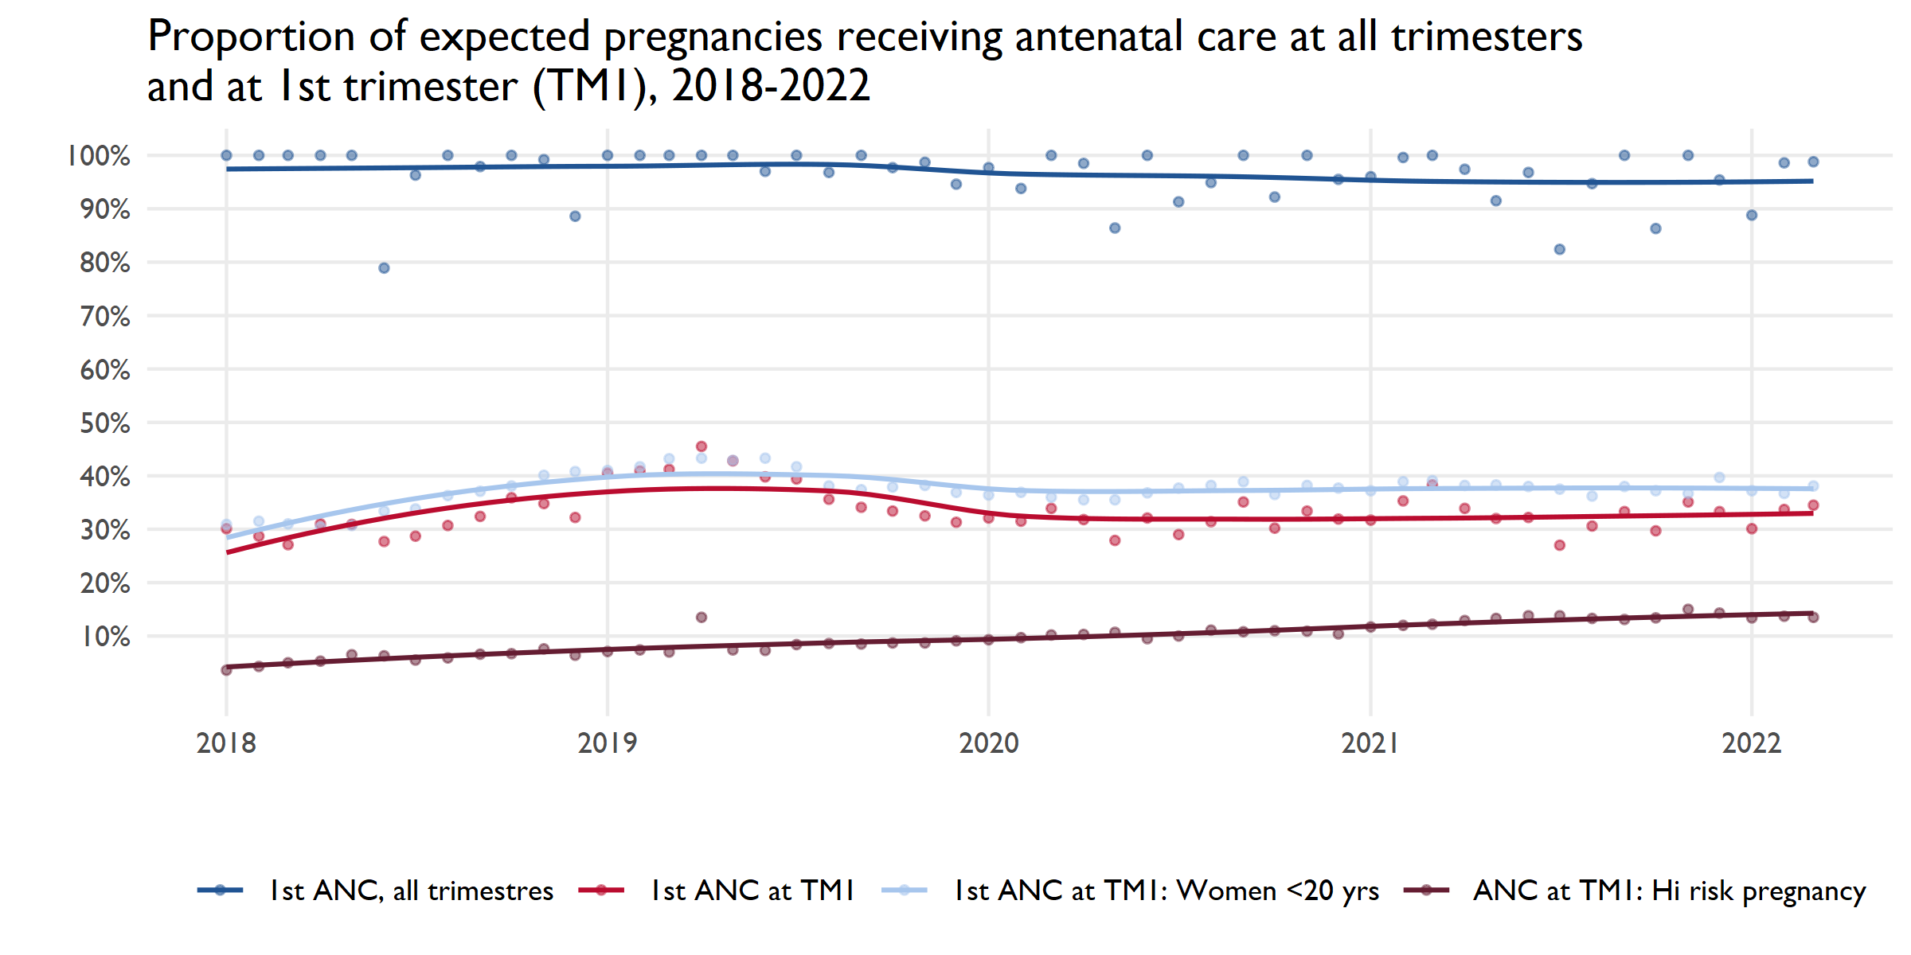
Notes:
Presenter notes:
Rather than presenting the maternal and perinatal indicators in the order of the dashboard (ie. From negative to positive directions), I will be showing you the indicators in the order of a woman’s pregnancy experience, starting with antenatal care.
Denominator is the expected pregnancies calculated from the estimated population based on the 2010 census.

Slide 5
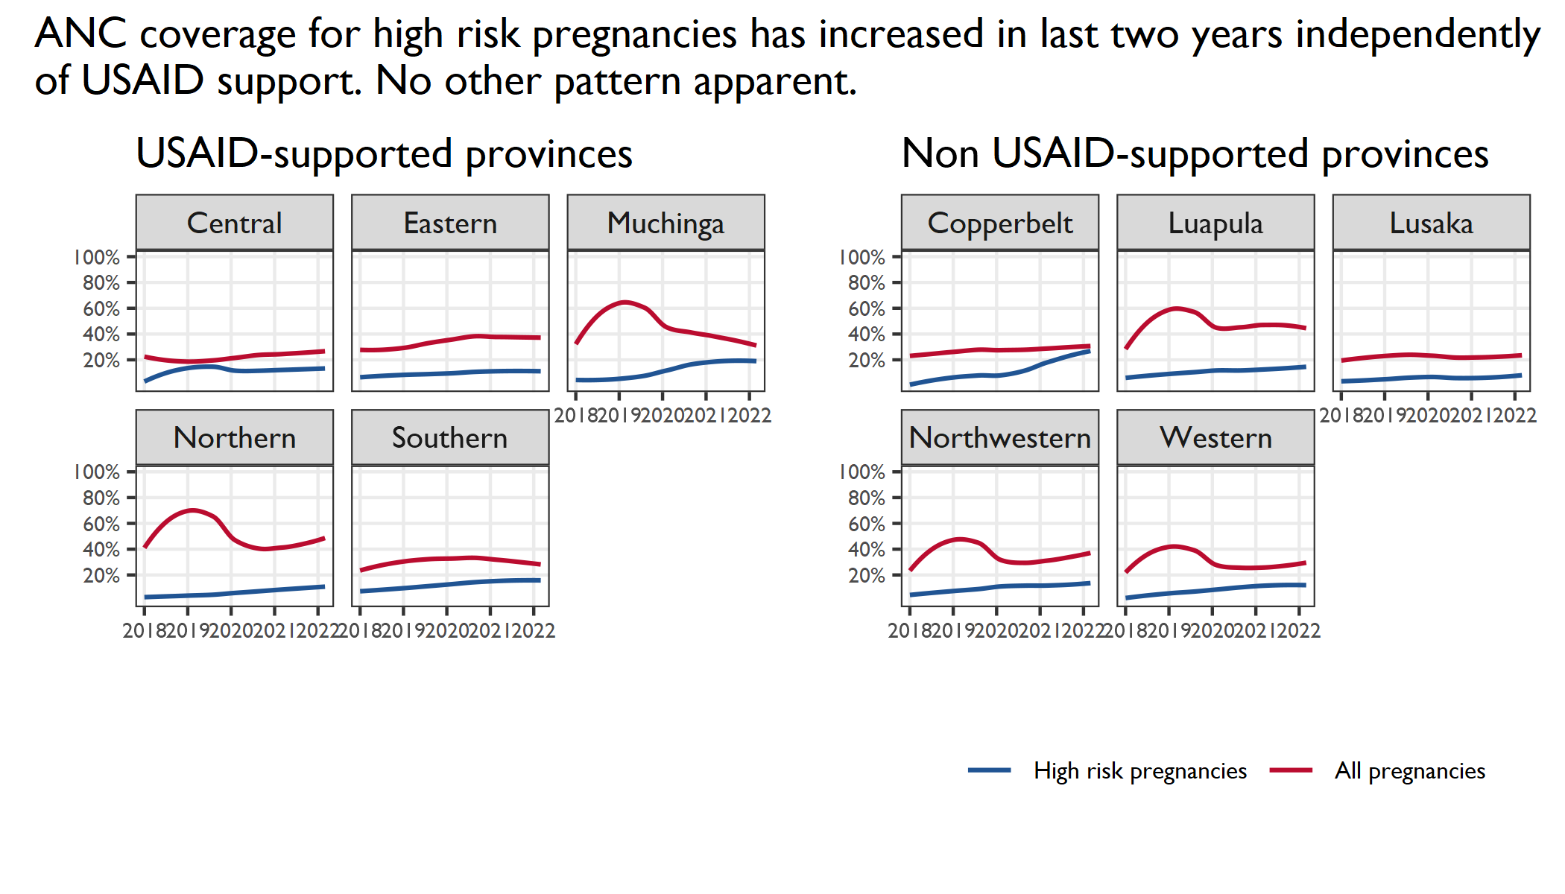

Slide 6
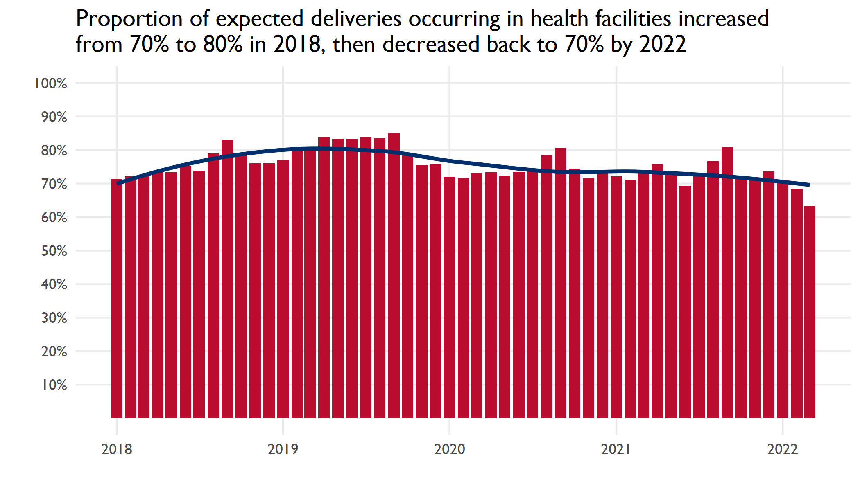
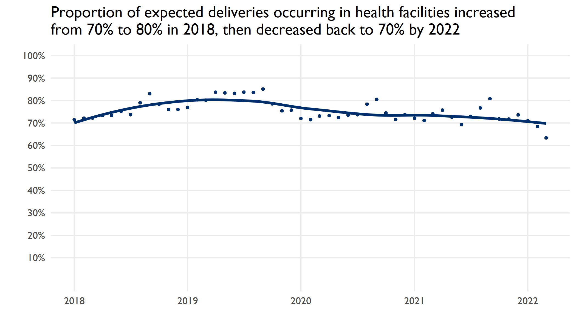
Notes:
Note to presenter:
The USAID comment suggests USAID thinks there are national targets for this indicator. There are not. The below indicator is related but different.
OP2.7 Percentage of institutional deliveries supervised by unskilled staff

Slide 7
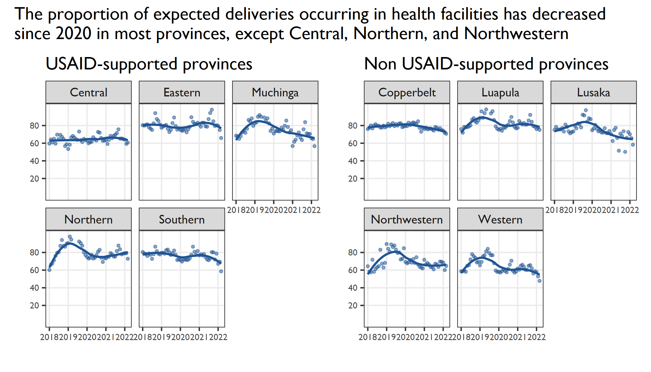
Notes:
A USAID comment requested a summary: “take-away” of USAID vs non-USAID supported provinces. Unfortunately there is no take-away. We are looking at indicator data and the process of interpreting them and coming to conclusions of the “so-what” needs to be a collaborative effort. In other words, the details of the activities that USAID is supporting and managing (ie. FHN, MOMENT and G2G) that might be relevant to better interpret and guide further analysis need to be facilitated by USAID.
Northern province reported on strategies have been put in place to sustain the Deliveries at Health Facility in Northern:
Local Leaders (Chiefs and Headmen/women) are engaged at making sure all those that are pregnant deliver at the health Facilities. The Majority of these leaders are adhering to this and any Abrogation of this is met with punishment for the mother, father and the Family.
Safe Motherhood Action Groups (SMAGs) have been formed in most Health Centers to spearhead this agenda. All mothers that are pregnant are registered and followed up to labor. All mothers are encouraged to deliver at the health facilities by the SMAGs.
All the at-risk Mothers are transported either to health Facility or Hospital for Monitoring until delivery time.
In Some cases, mothers are provided with Humpers after deliveries, which include baby clothes and ITNs.
Central province
Several traditional leaders have made by-laws whereby if a woman delivers from home, then the client's husband must pay some cement meant to construct a health post, or a goat to feed women in the waiting shelter.
They were also trained in safe motherhood.

Slide 8
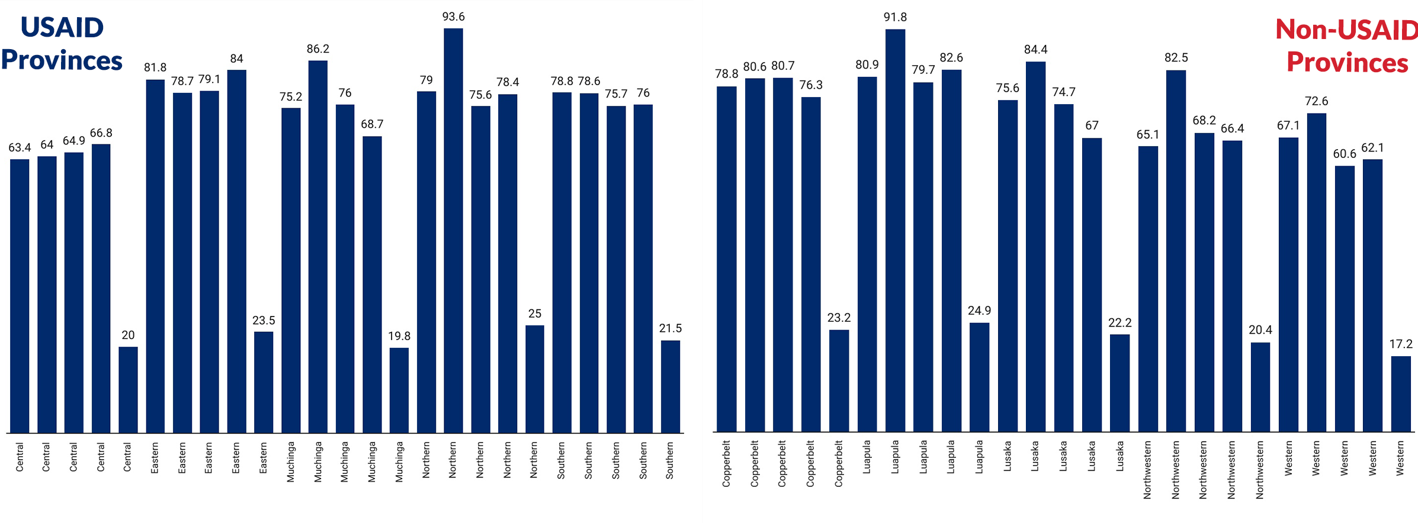
Proportions of expected deliveries occurring in health facilities has decreased since 2020 except for Central, Northern and North-Western

Slide 9
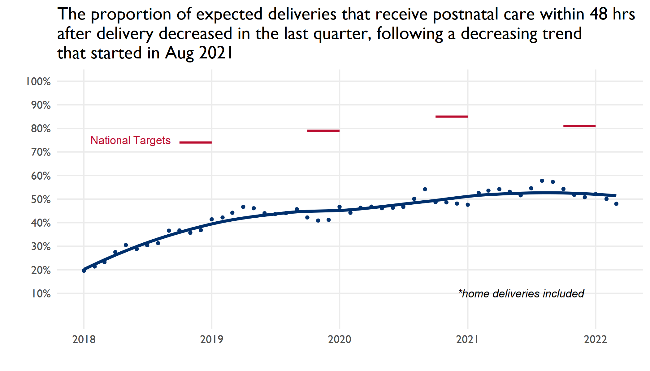

Slide 10
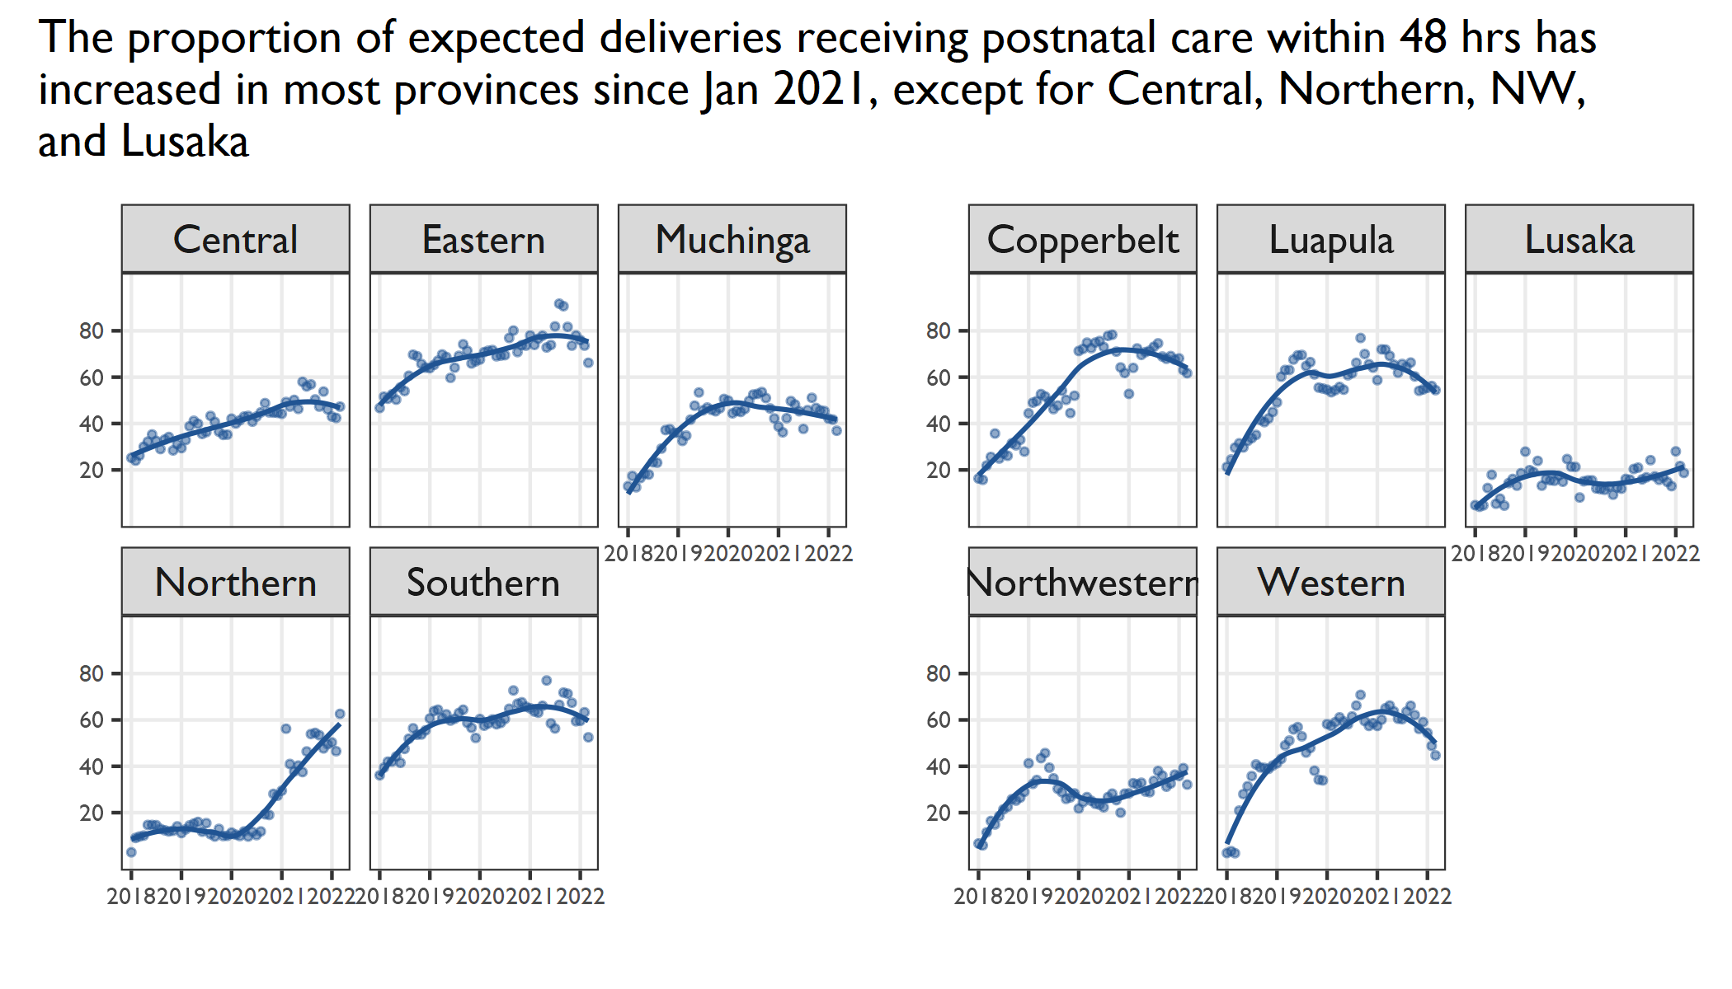
Notes:
Central province
That is 48 hrs postnatal care, for the HFs with adequate space, clients are kept for 48 hrs. because the distances in our HFs are quite massive.
Community sensitization on importance of Facility delivery is ongoing.
All our Chiefs were oriented in key issues in Safe Motherhood so that they can be the ambassadors in the community.
Northern province
Most mothers insist upon delivery to be discharged immediately. This means that you may not be able to keep them for the one day after or before 48hrs. Most Health Facilities lack a post-natal area for mothers that have just delivered. Most of those that may have challenges and need monitoring are retained in the labor rooms.
Most mothers stay a bit far from the health facilities, and even when advised to come back for post-natal before 48hrs may not make it back in time.
Some communities are sensitive to the movement of a mother who has just delivered to be moving around.

Slide 11
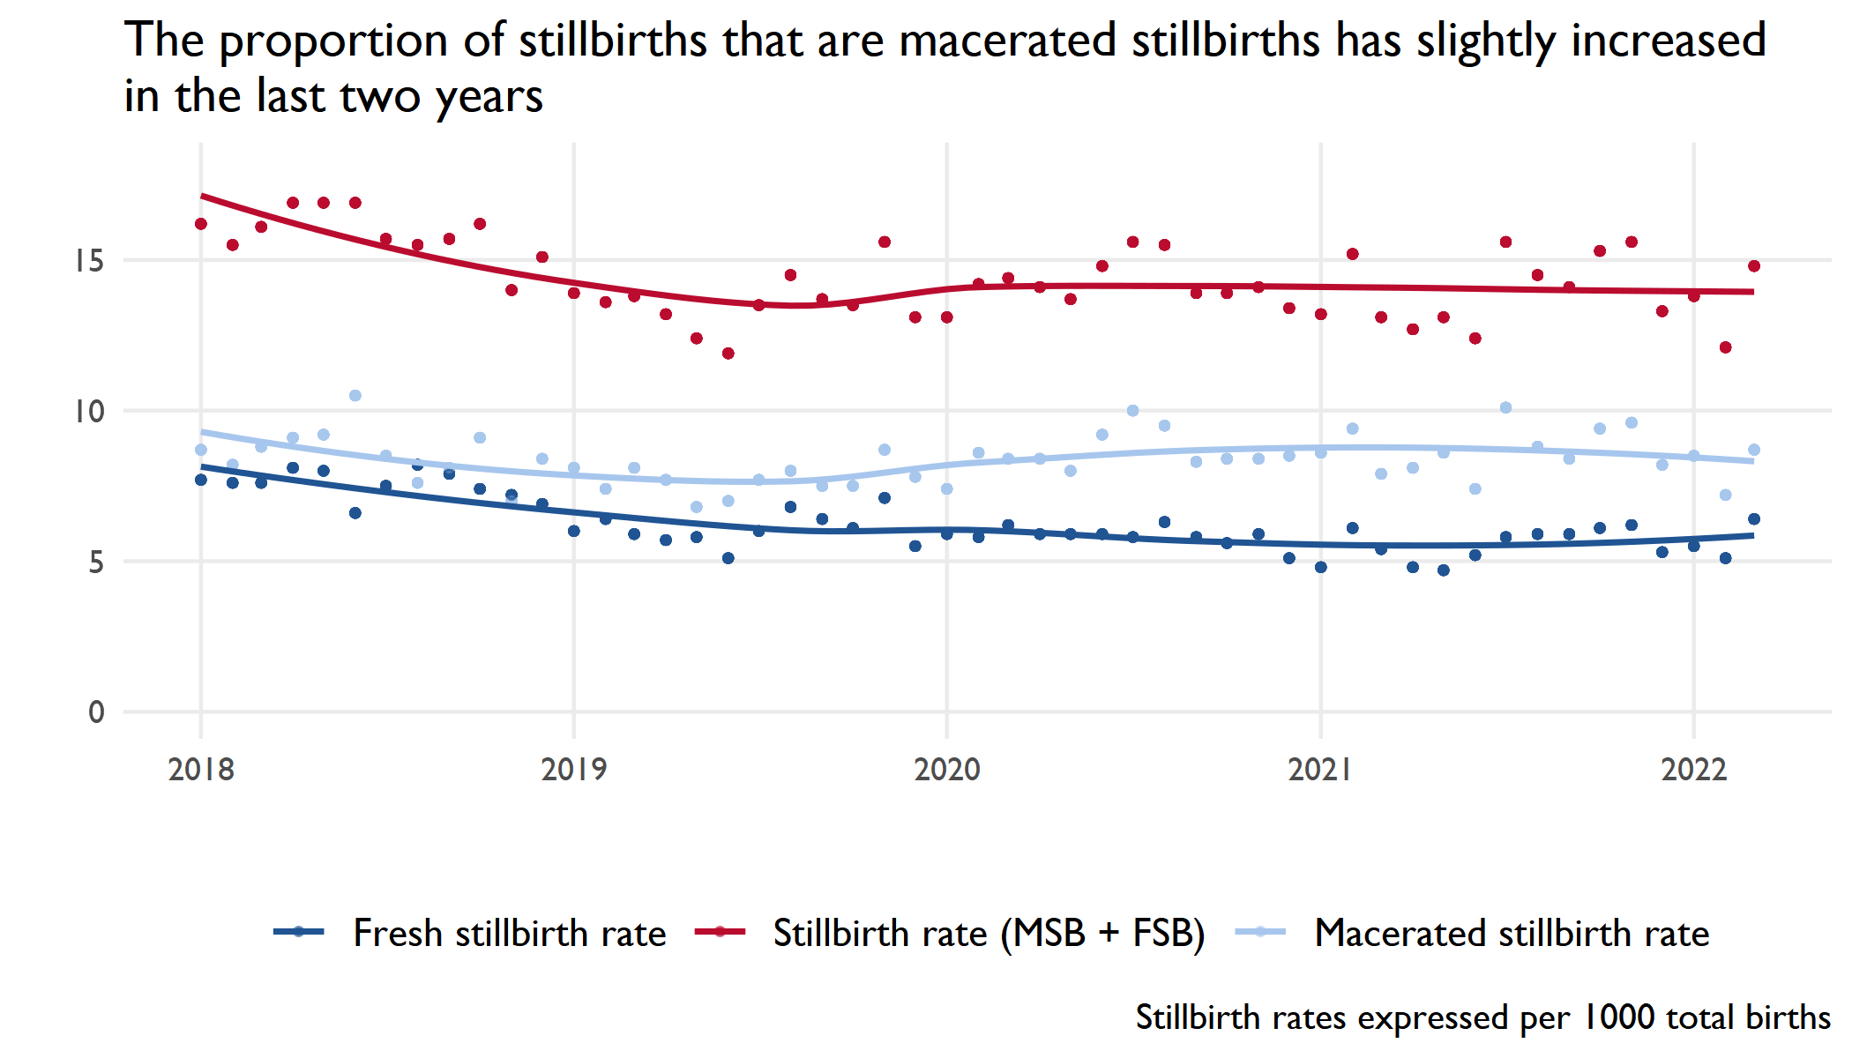
Notes:
MSB is higher the FSB, this was discussed during the Newborn subcommittee TWG to be different compared to many countries. This is partly due to documentation issues as providers do not document correctly for fear of blame. Measures are being put in place to sensitize providers to avoid blame game and document the correctly at what point stillbirth occurred.

Slide 12
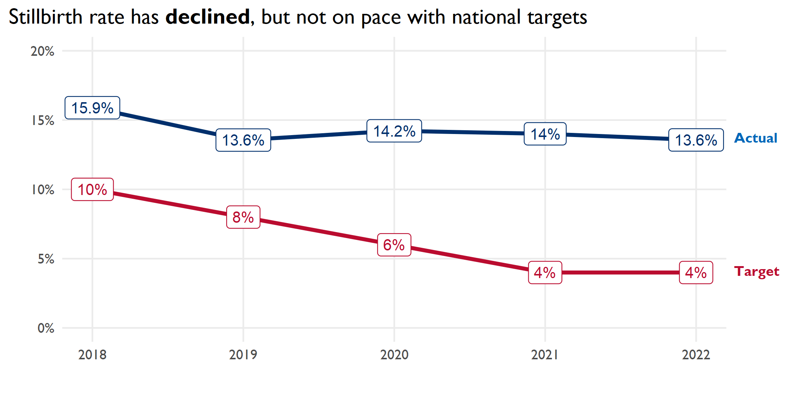

Slide 13
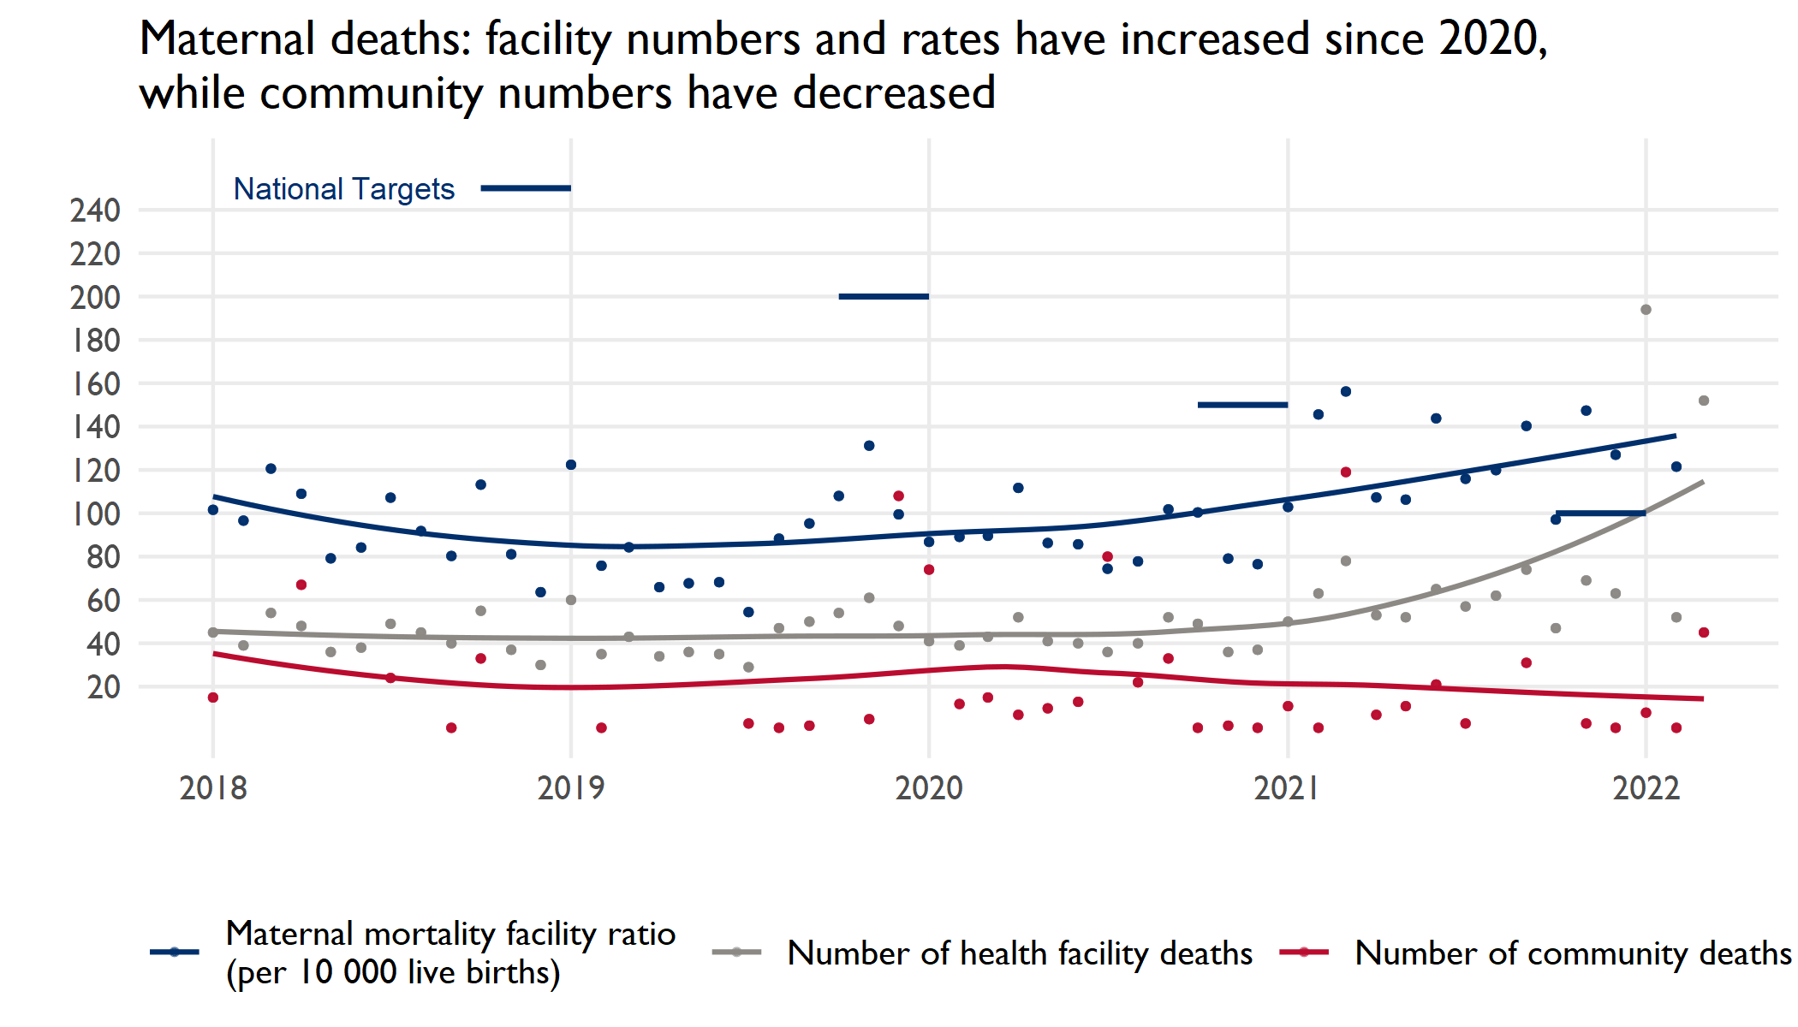
Notes:
Presenter notes:
- Please note this slide contains both the maternal mortality ratio and absolute numbers of deaths on the same slide
- While the number of community maternal deaths appear to have decreased in the last two years, the reliability of such data is likely lower, and could have been affected by reporting challenges

Slide 14
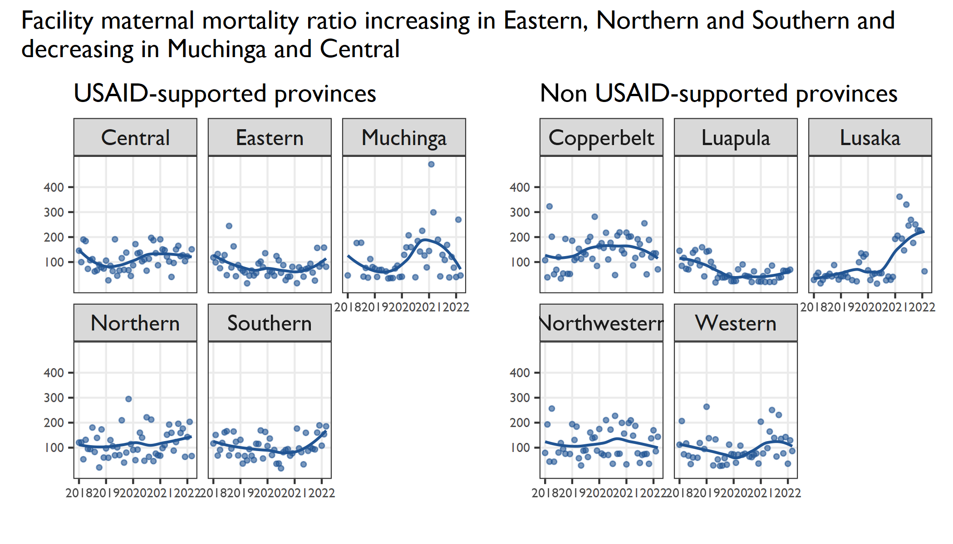
Notes:
Presenter notes:
Facility maternal mortality ratio includes deaths that take place in the community that are reported to the facility

Slide 15
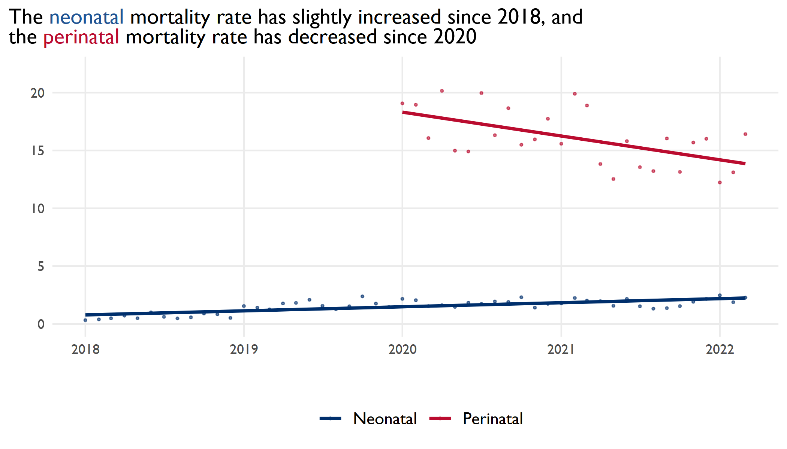

Slide 16
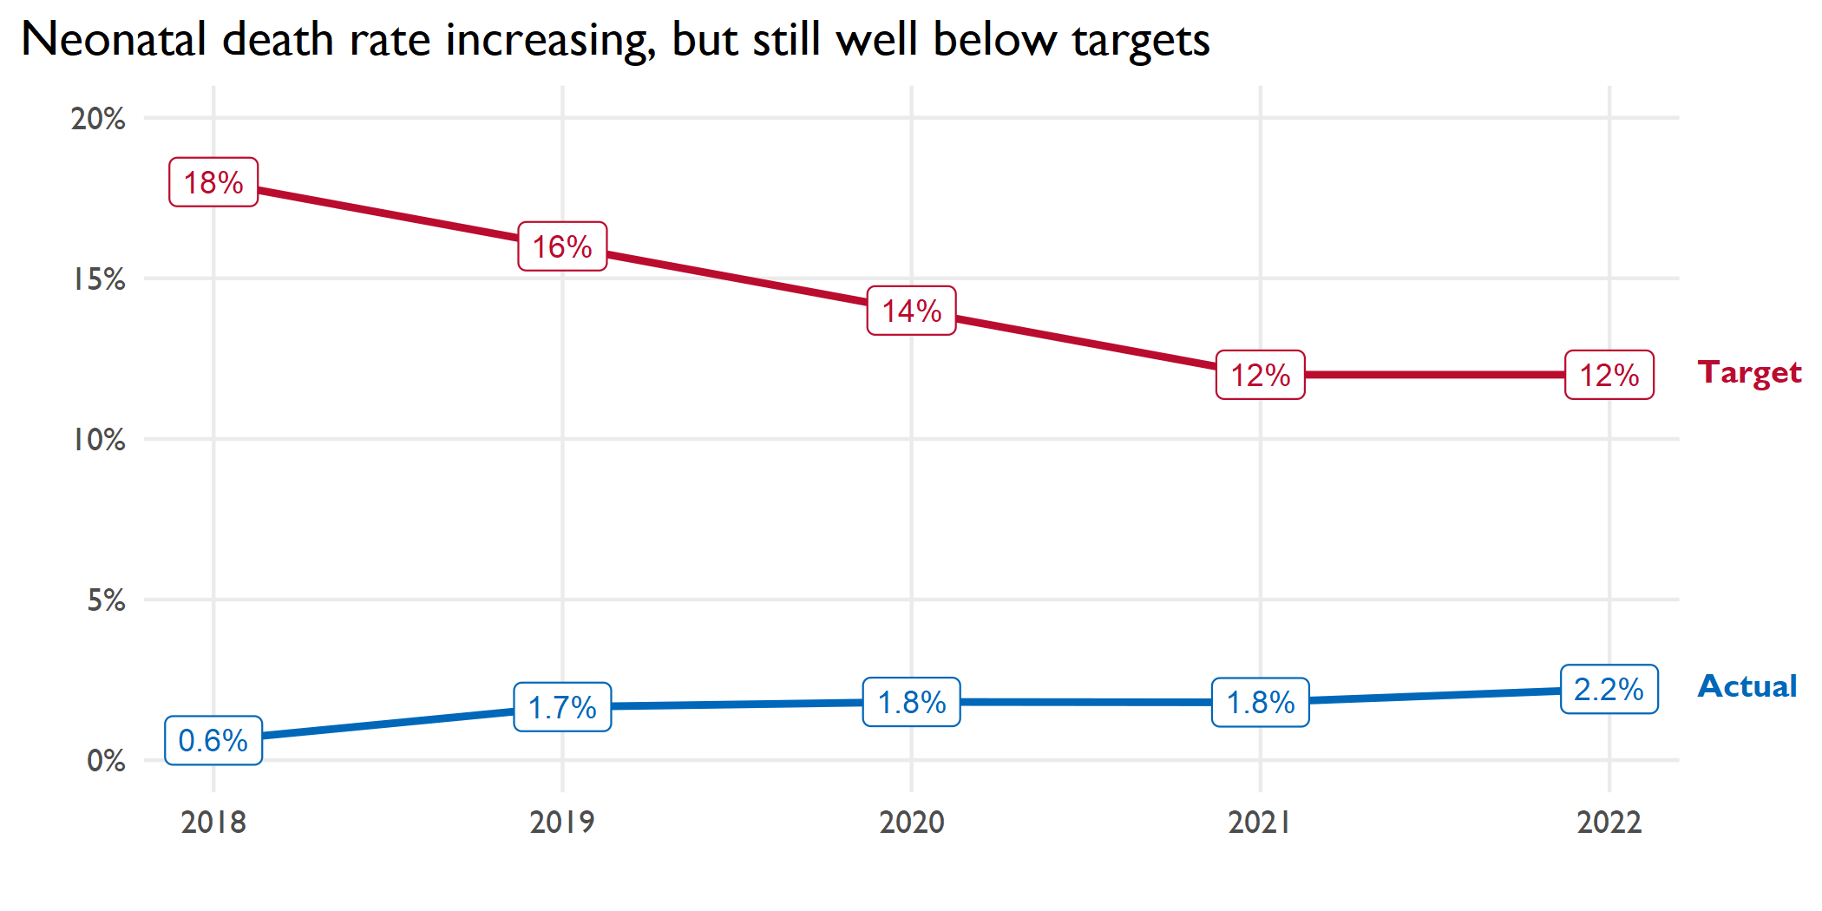

Slide 17
Child Health, Immunization, and Nutrition

Slide 18
Child Health Dashboard Direction of annual indicator data Jan 2020 to Jan-Mar 2022
Negative/ Undesirable Direction | No Change | Positive Direction
 | Measles coverage at 1 and 2 years
 | DPT-Hib-Hep coverage at 1 year
 | BCG coverage at 1 year
 | Fully immunized coverage for <1
 | Fully immunized coverage for <2
 | Breastfeeding within 1 hour of birth
 | Exclusive breastfeeding up to 6 months of age
 | Vitamin A at 6 and 11 months
6/2/2022

Slide 19
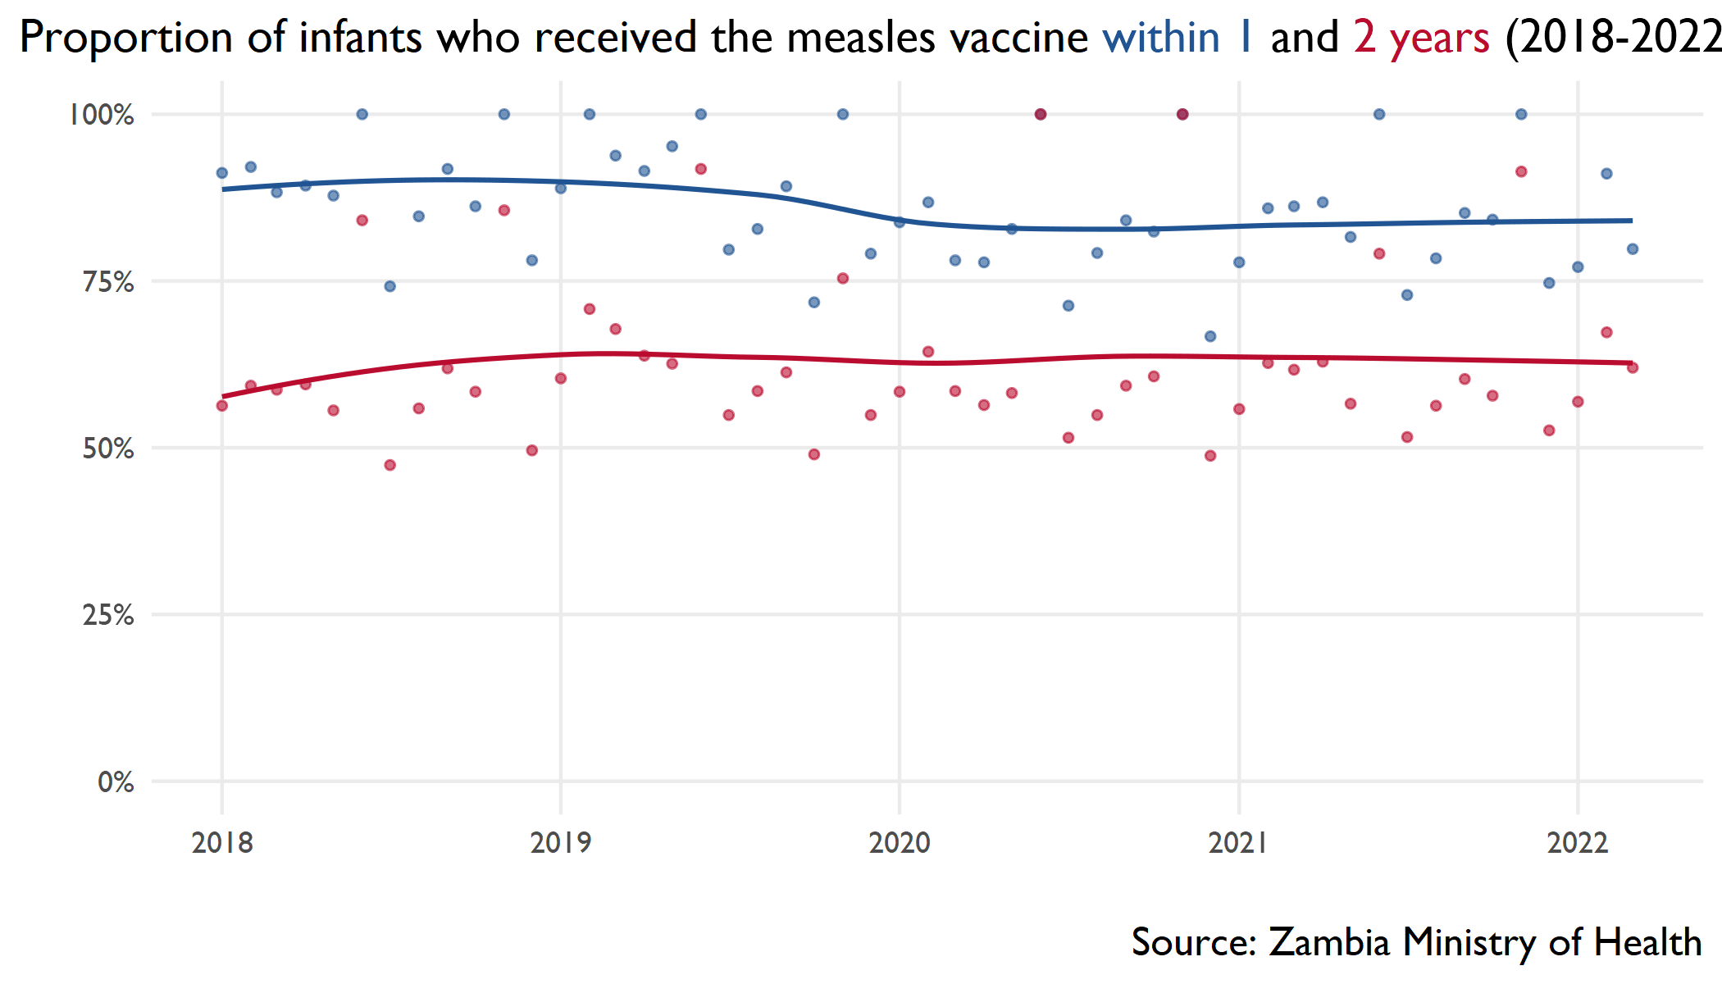

Slide 20
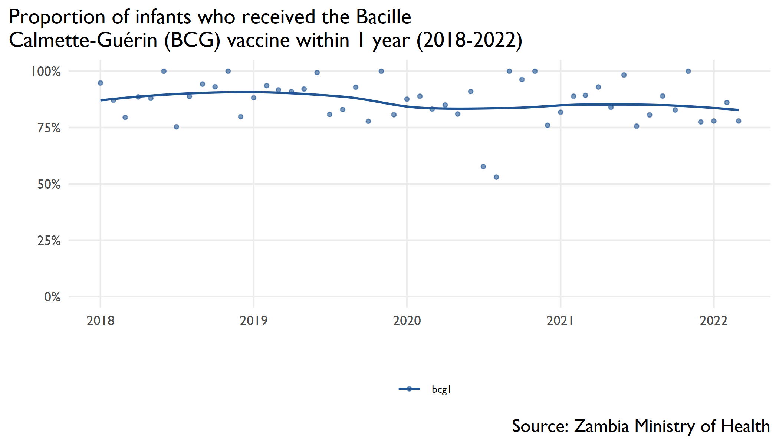

Slide 21
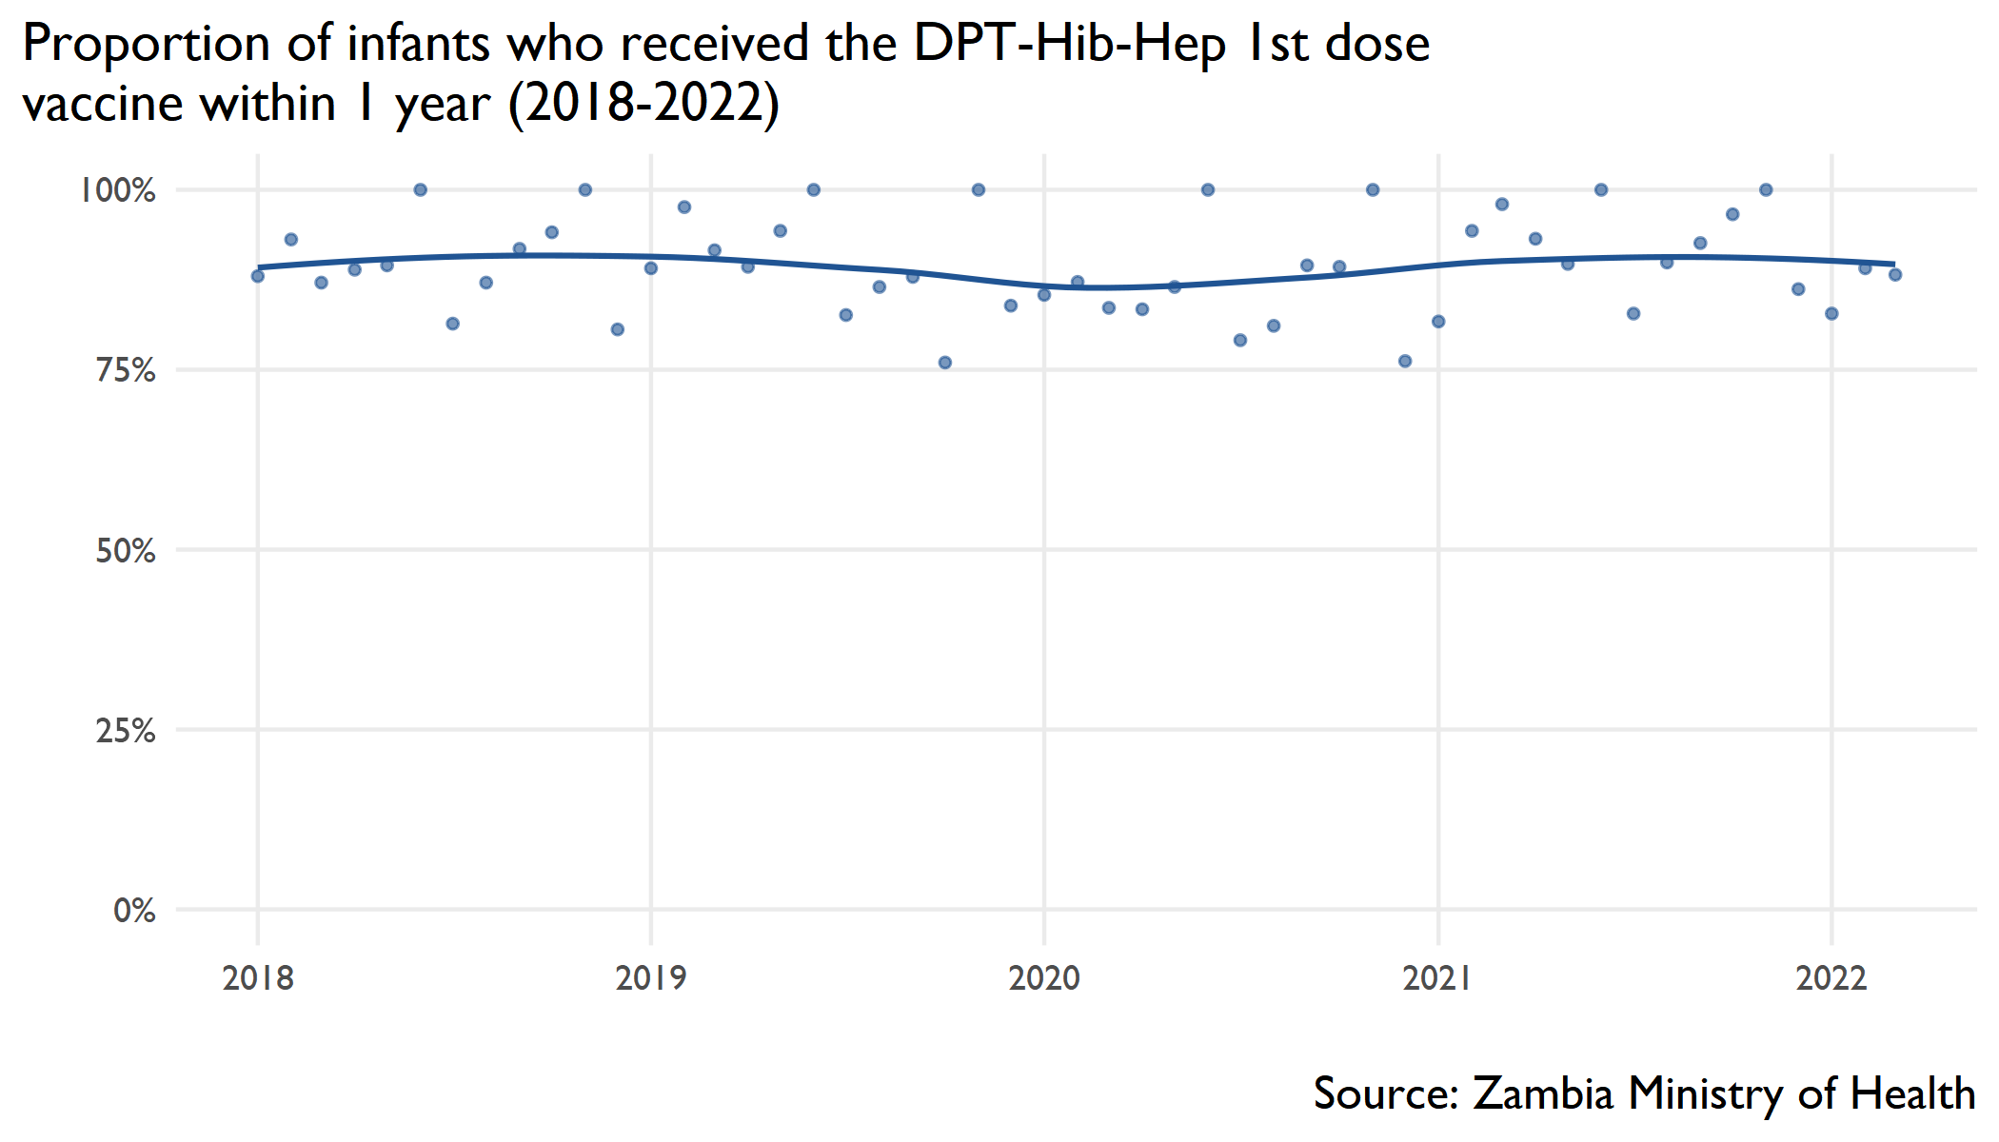

Slide 22
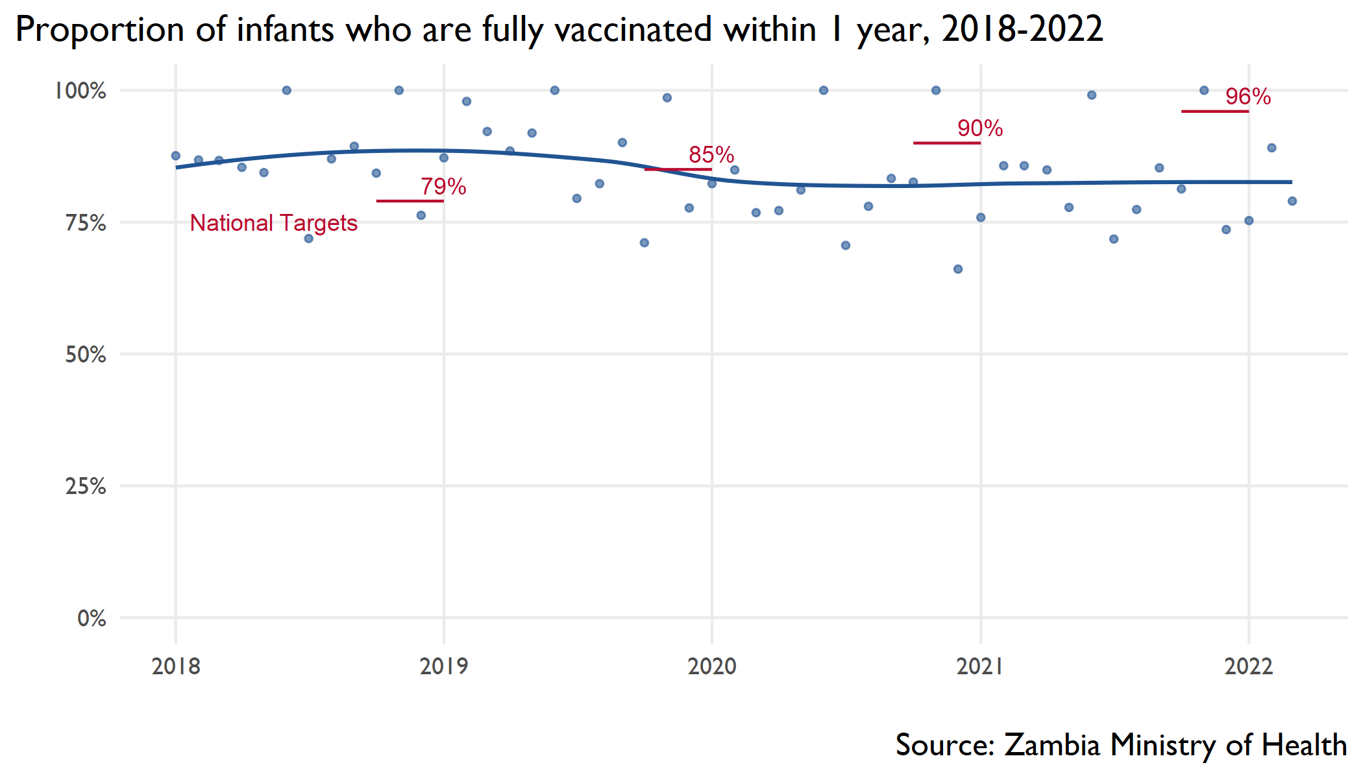
Proportion of children under one year old that are fully immunized, 2018-2022

Slide 23
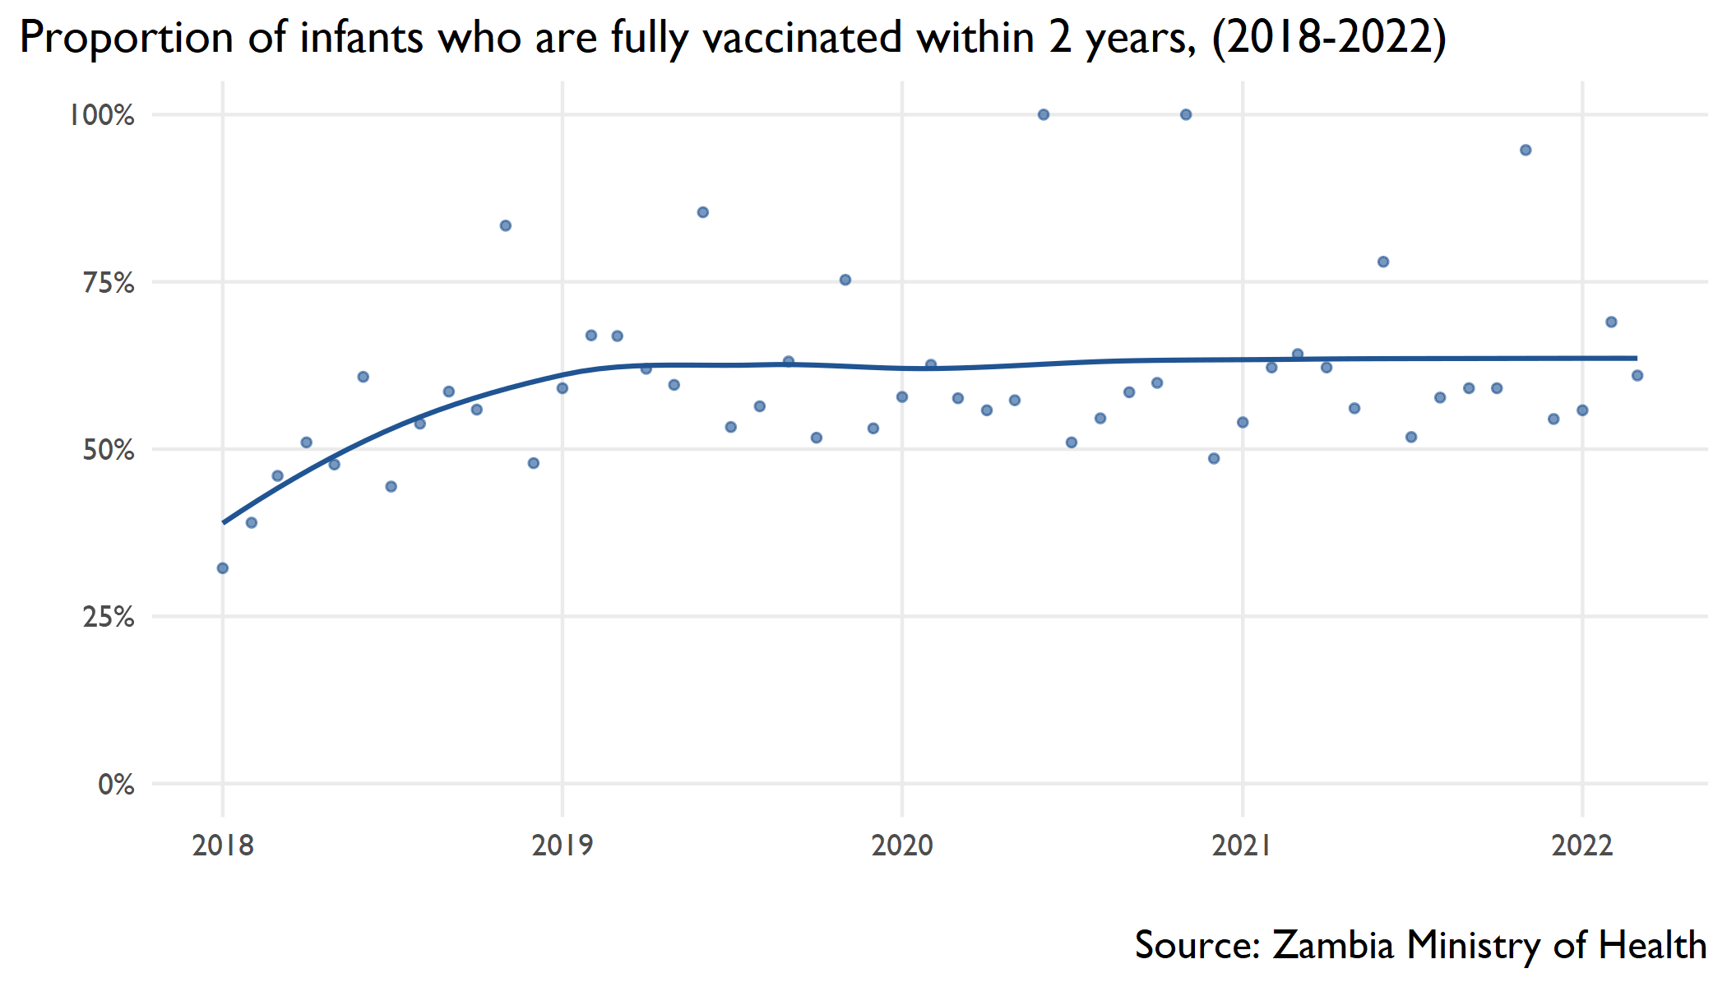
Proportion of children under two years old that are fully immunized, 2018-2022

Slide 24
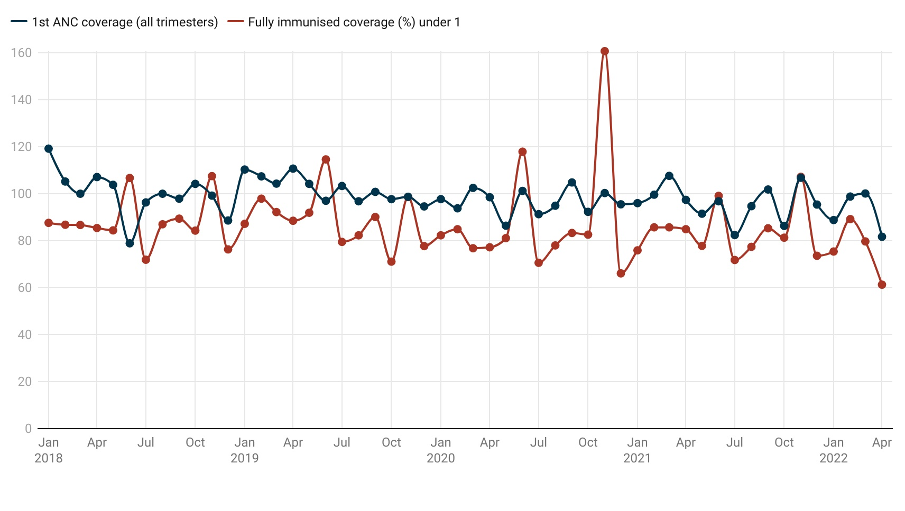
Fully immunized infants and ANC coverage 2018-2022

Slide 25
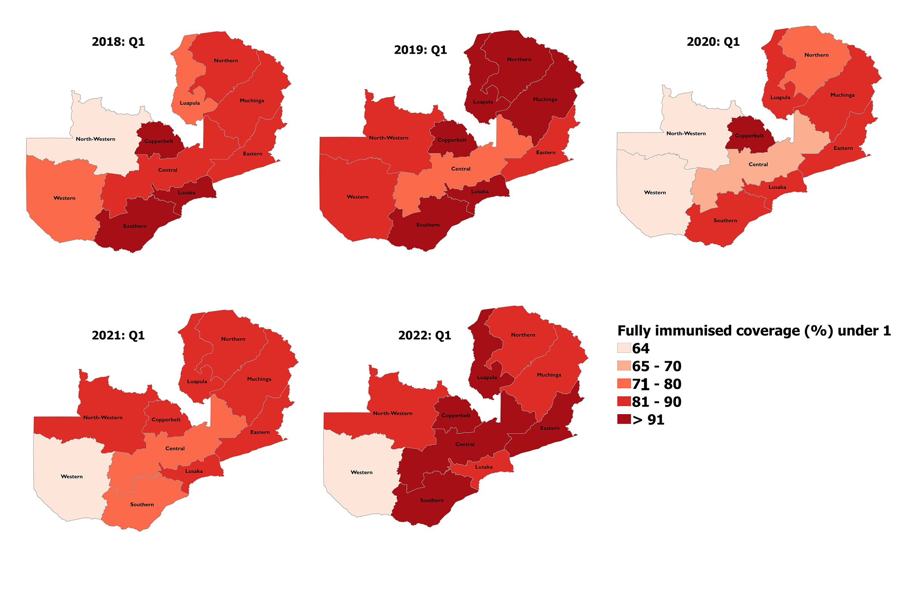
Proportion of children <1 fully immunized

Slide 26
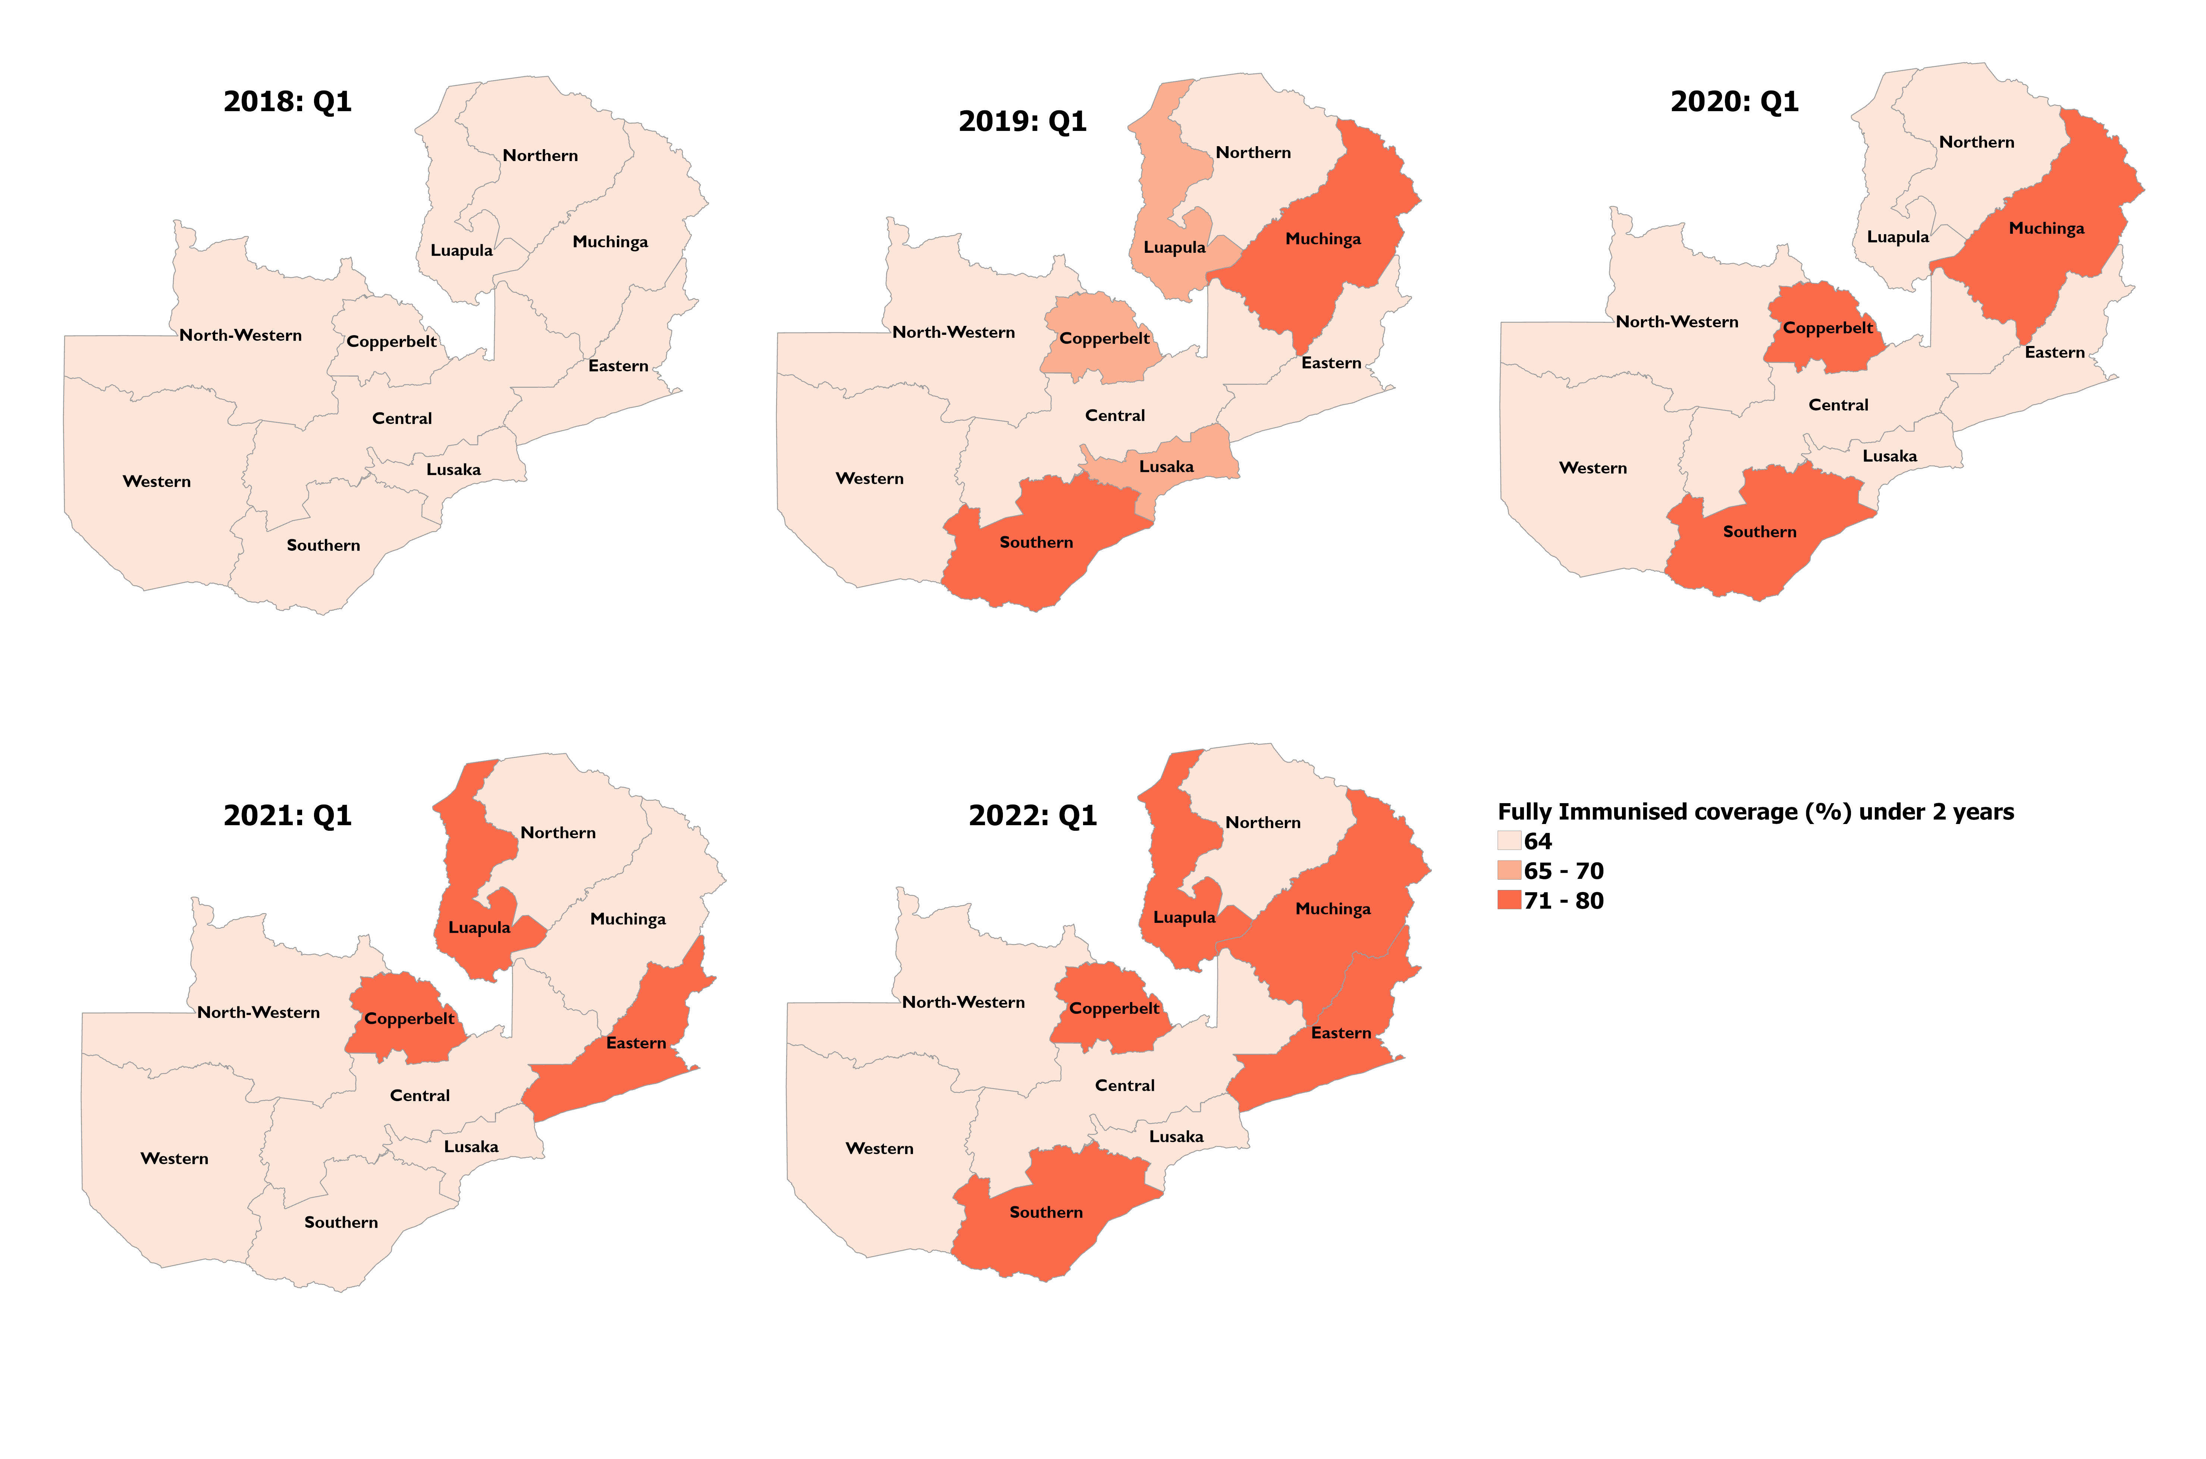
Proportion of children <2 fully immunized

Slide 27
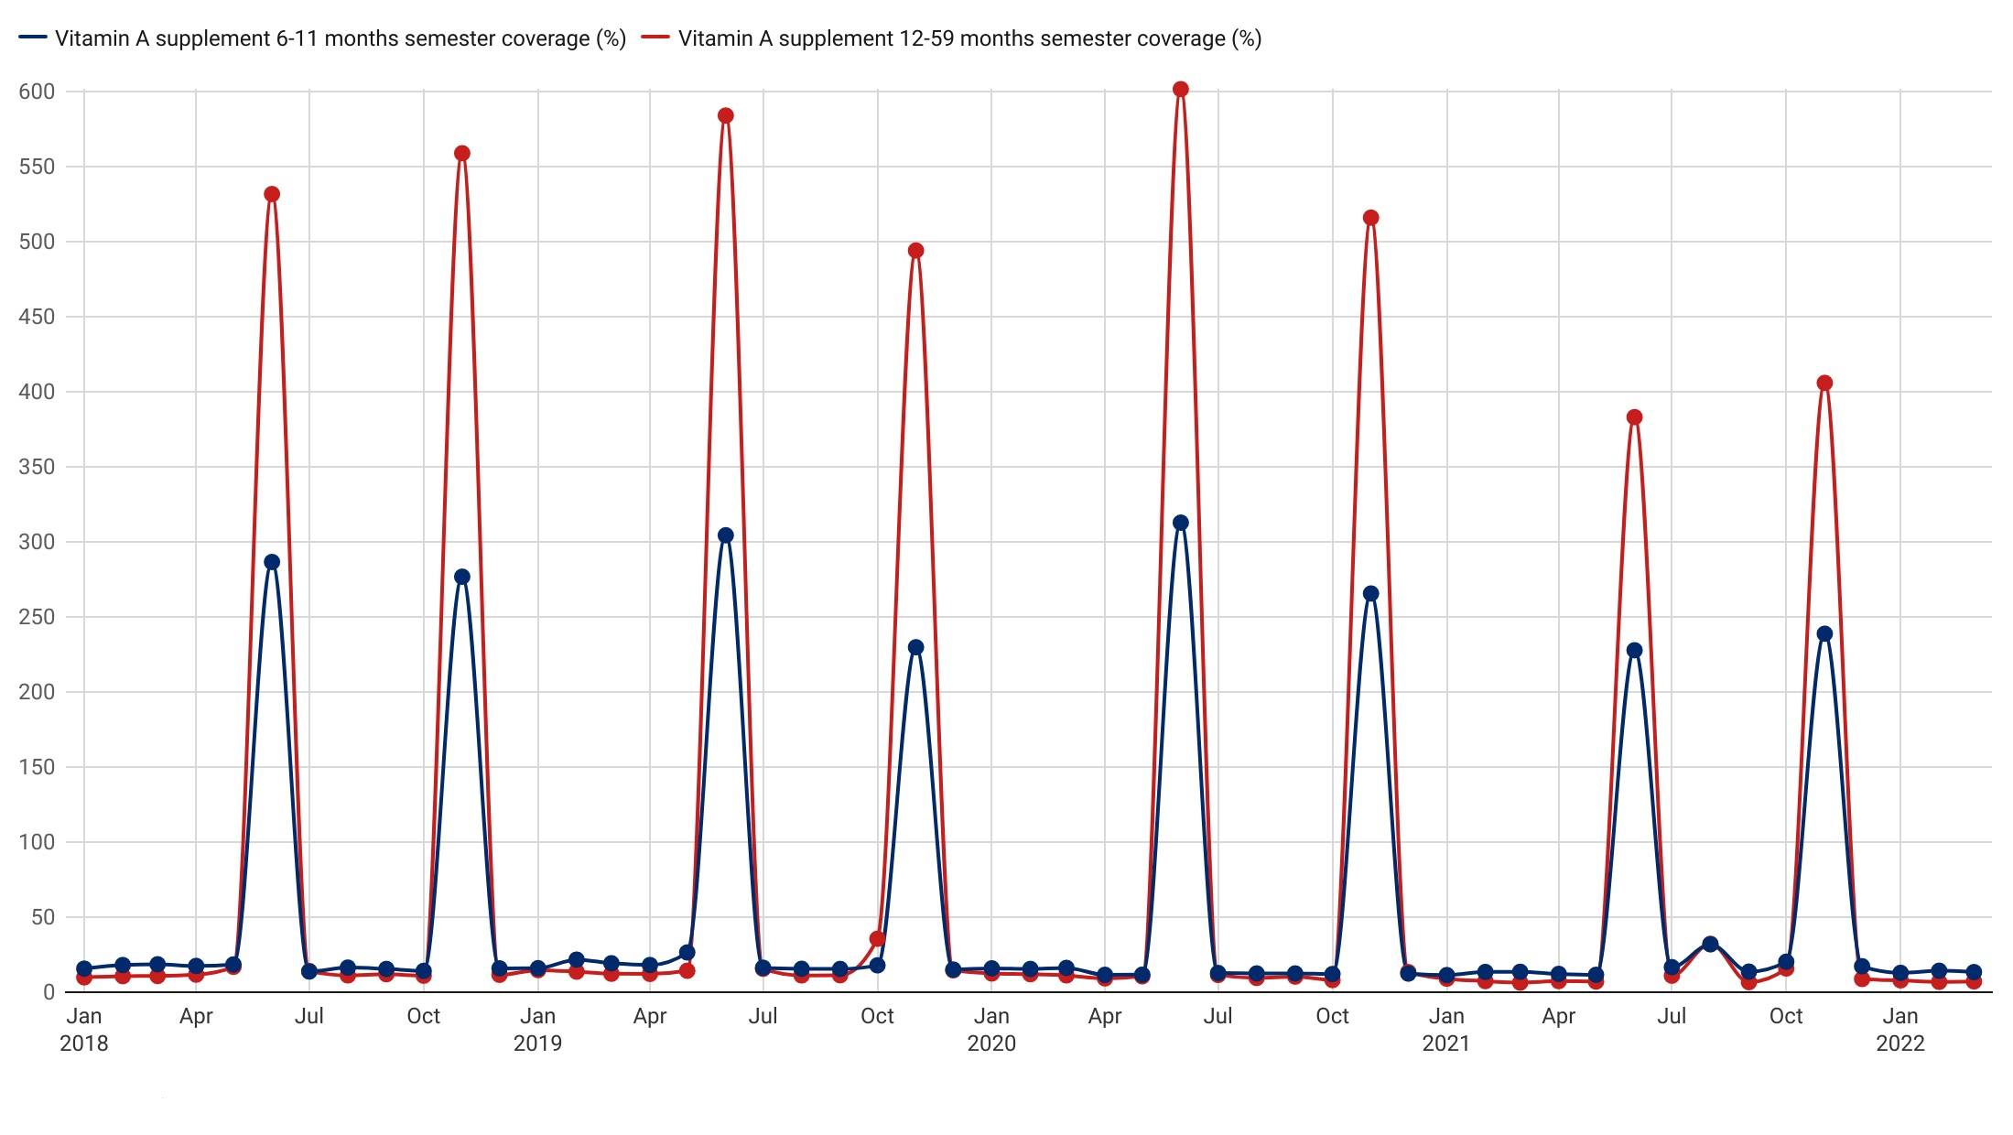
Infants who received Vitamin A supplements with spikes in June & November representing Child-heath Campaign periods, 2018-2022

Slide 28
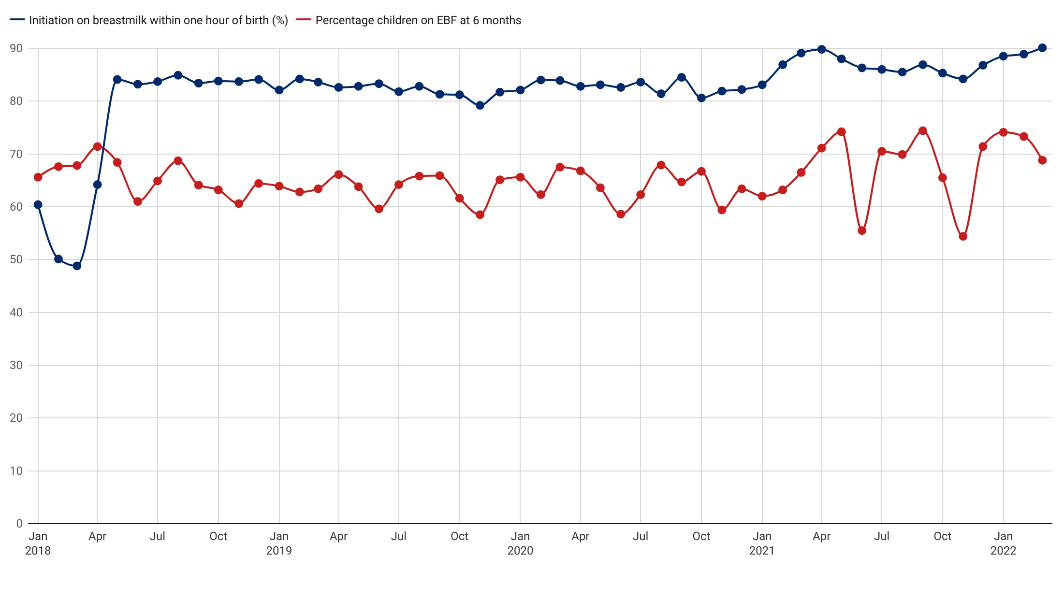
Monthly Proportions of infant's bread-feed at an hour afterbirth and EBF at 6months, 2018-2022

Slide 29

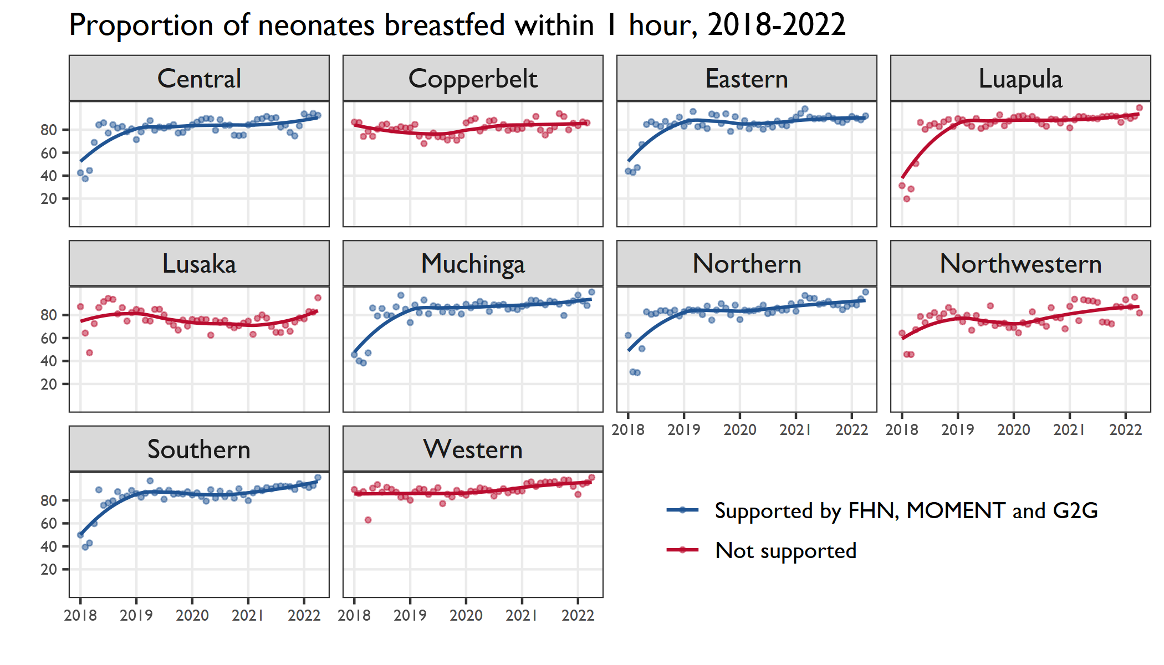

G2G supported

Slide 30
Family Planning

Slide 31
Family Planning Dashboard Direction of annual indicator data Jan 2020 to Jan-Mar 2022
Negative Direction | No Change | Positive Direction
CHA worker visits to women of reproductive age |  | Coverage of modern FP initiation for women of reproductive age visited by CHA
Women adopting modern FP methods |  | Proportion of new FP acceptors
 |  | Number of IUDs inserted compared to number of hormonal IUDs available
6/2/2022

Slide 32
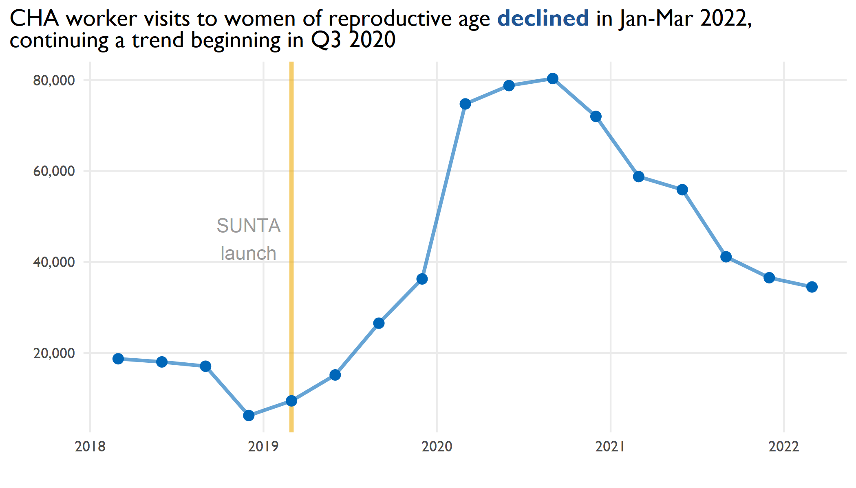
Notes:
In the health facilities where there are CHAs, they are the point of contact and project-community liaison for the project.
Under health and nutrition, they provide capacity strengthening and supportive supervision to SUN Mother Support Groups, Family planning Community Based Distributors and Early Childhood Development facilitators
Under WASH, they provide supportive supervision to the Sanitation Action Groups and the community champions
In health facilities that do not have Environmental Health Technologists, they also perform data management functions including receiving/reviewing monitoring reports from community groups/volunteers and consolidate data for the catchment for onward submission to the districts

Slide 33
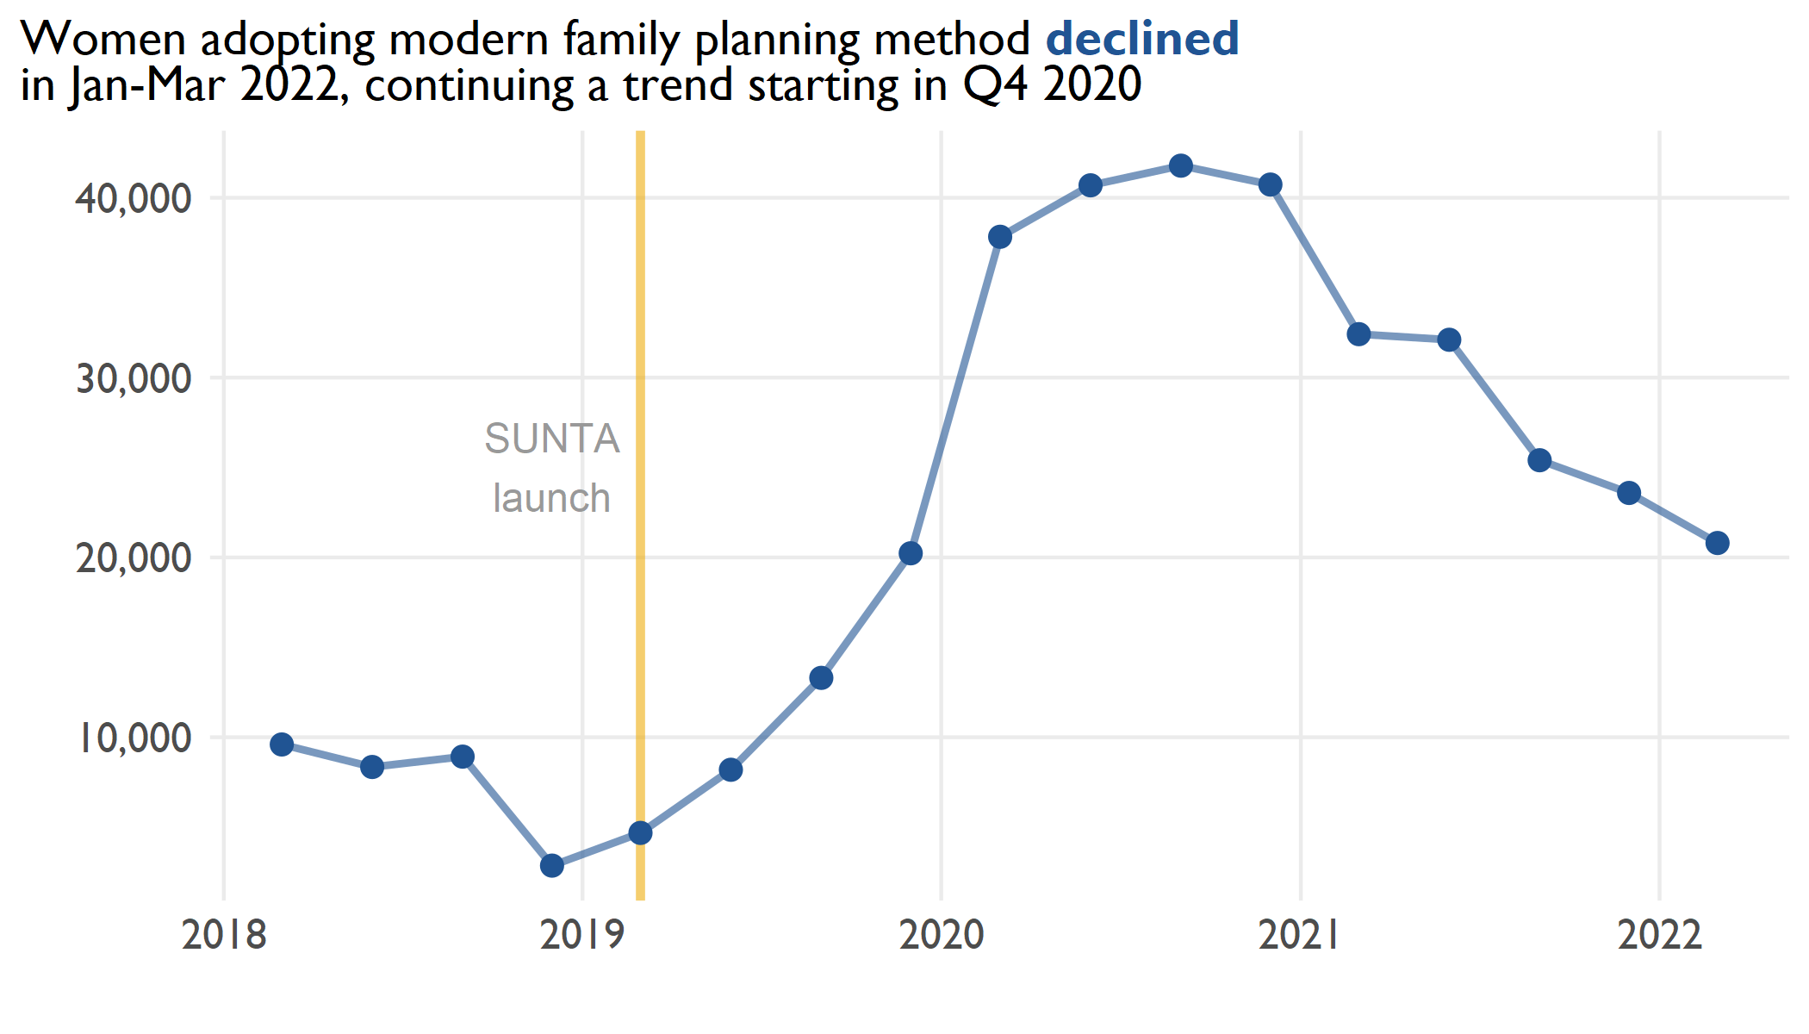
Notes:
For the bump around 2020, there were a number of activities that the SUNTA project supported with intensity during this time, that required increased community presence by health facility staff, including CHAs
The training of SUN Mother Support Group facilitators leading to formation of SMSGs required community level supervision by health facility staff including the CHAs
This is the time that the project intensified beneficiary household registration and validation which also involved health facility staff, including the CHAs
The training of Family Planning CBDs required health facility staff to be attached to the CBDs in providing facility and community level supervision

Slide 34
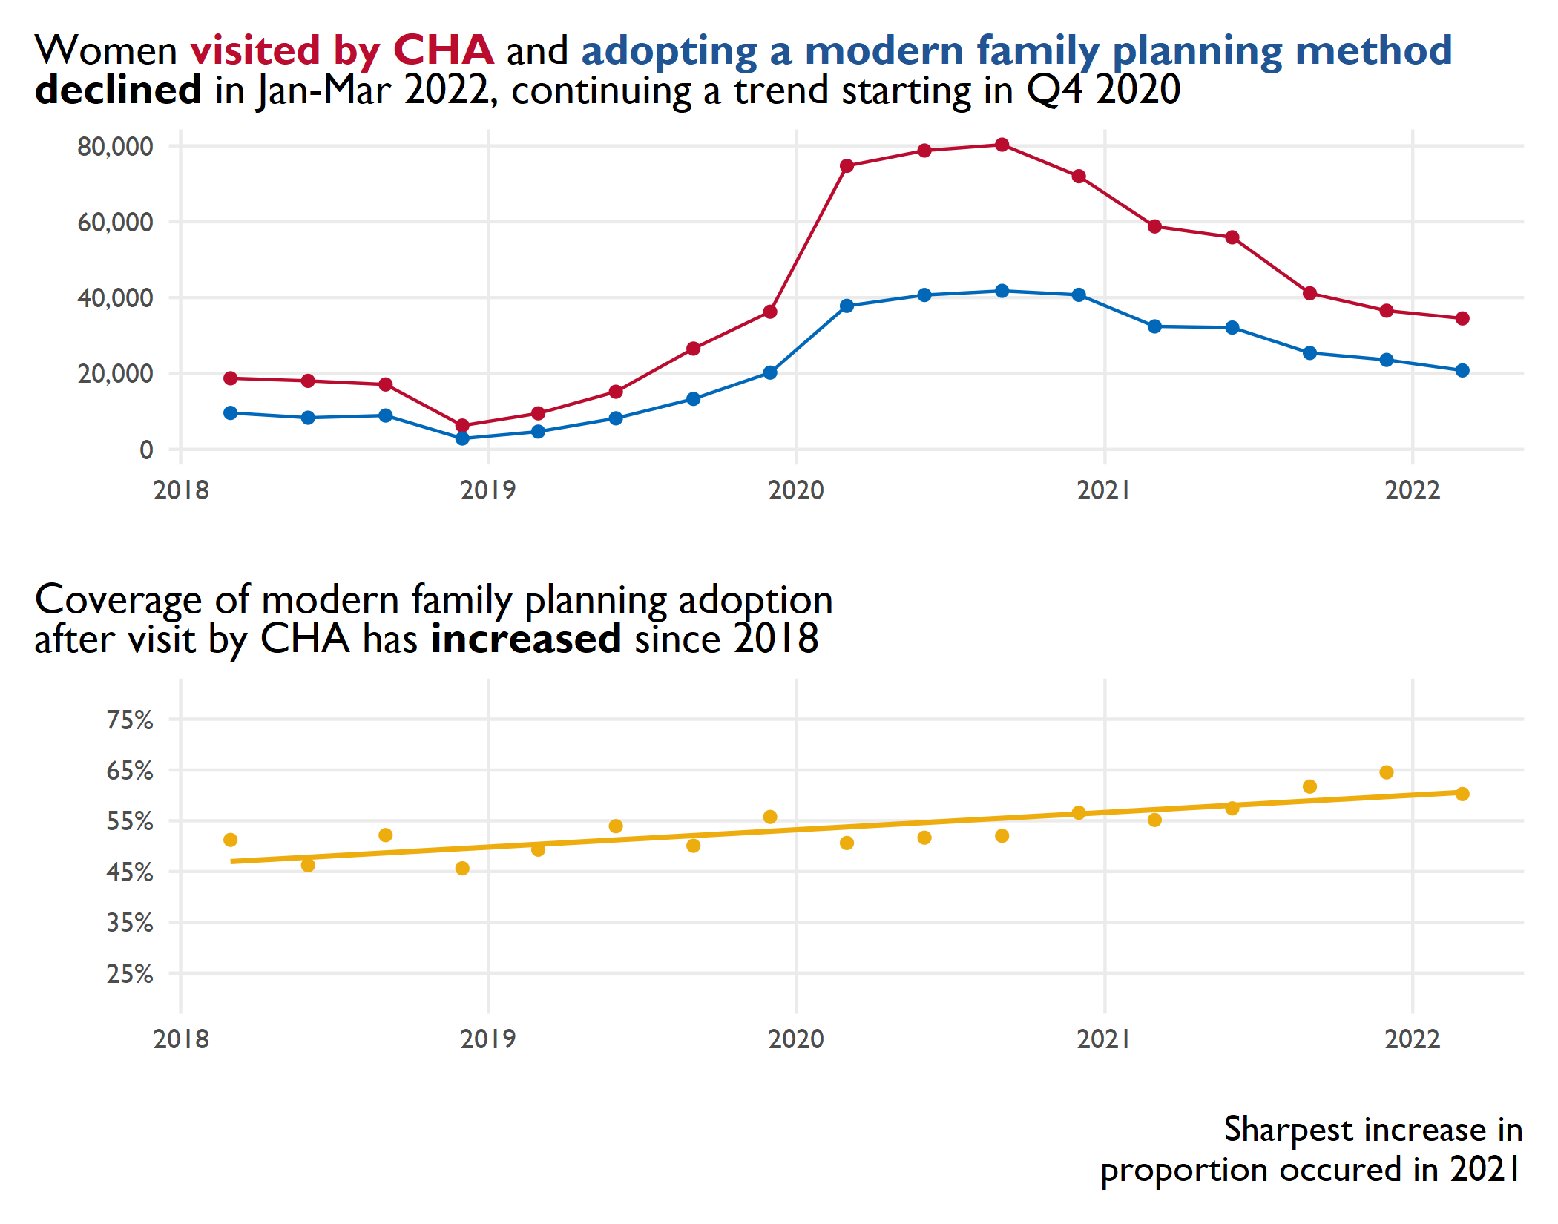
Notes:
SUNTA does not really have CHAs rather they provide capacity strengthening and supportive supervision to SUN Mother Support Groups, Family planning Community Based Distributors and Early Childhood Development facilitators

Slide 35
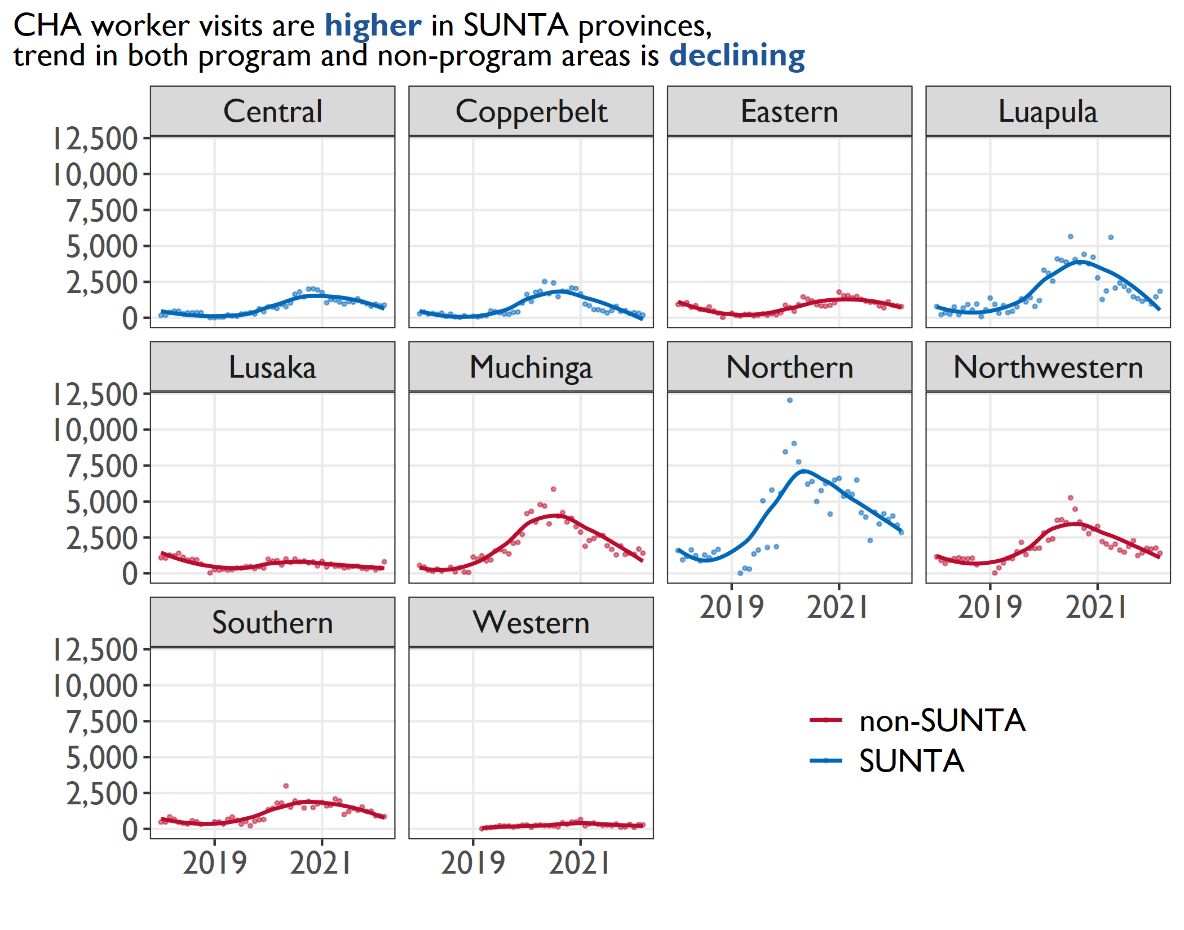
Notes:
For the bump around 2020, there were a number of activities that the SUNTA project supported with intensity during this time, that required increased community presence by health facility staff, including CHAs
The training of SUN Mother Support Group facilitators leading to formation of SMSGs required community level supervision by health facility staff including the CHAs
This is the time that the project intensified beneficiary household registration and validation which also involved health facility staff, including the CHAs
The training of Family Planning CBDs required health facility staff to be attached to the CBDs in providing facility and community level supervision

Slide 36
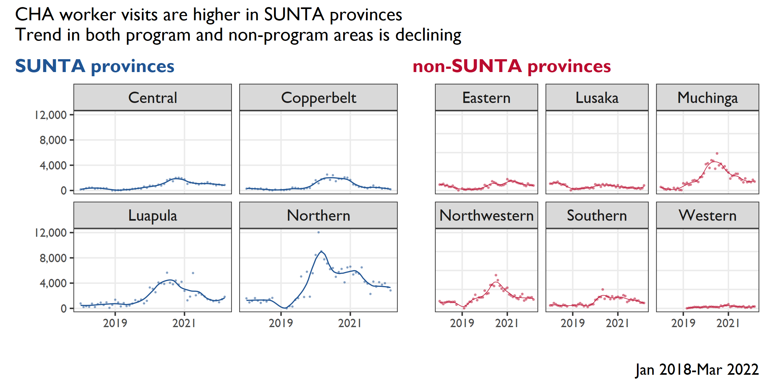
Notes:
For the bump, there were a number of activities that the project supported with intensity during this time, that required increased community presence by health facility staff, including CHAs
The training of SUN Mother Support Group facilitators leading to formation of SMSGs required community level supervision by health facility staff including the CHAs
This is the time that the project intensified beneficiary household registration and validation which also involved health facility staff, including the CHAs
The training of Family Planning CBDs required health facility staff to be attached to the CBDs in providing facility and community level supervision
Post this period, the health facility staff continued providing this support, but with reduced level of effort considering that a number of CBV supervisors had been trained and active

Slide 37
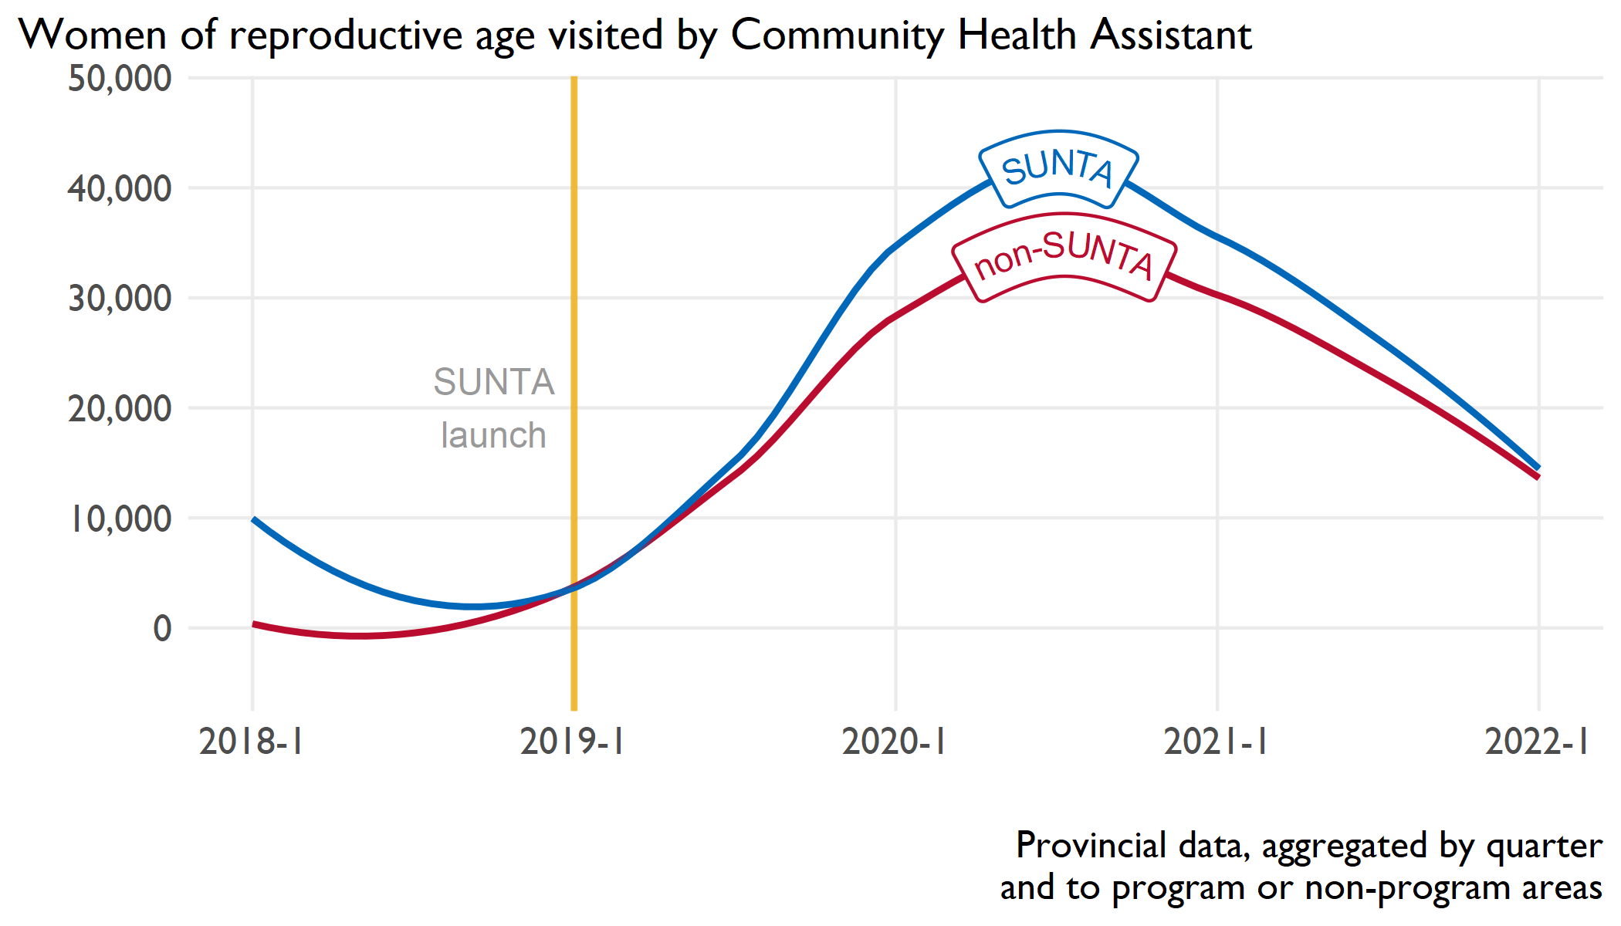

Slide 38
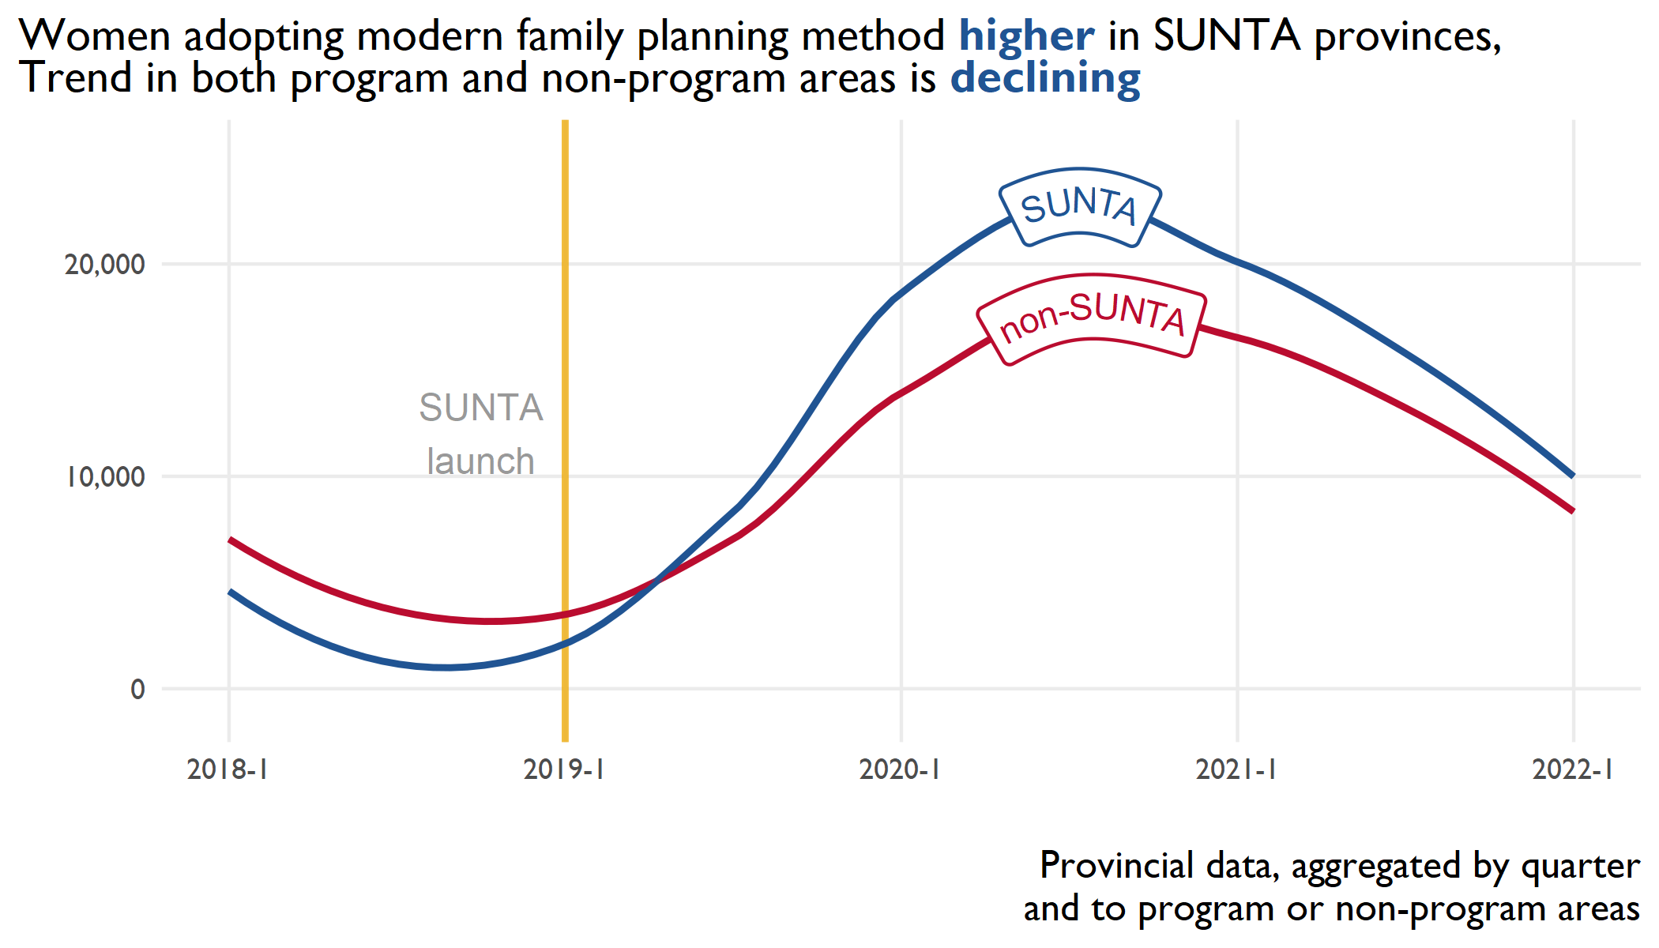
Notes:
SUNTA does not have CHAs rather they provide capacity strengthening and supportive supervision to SUN Mother Support Groups, Family planning Community Based Distributors and Early Childhood Development facilitators

Slide 39
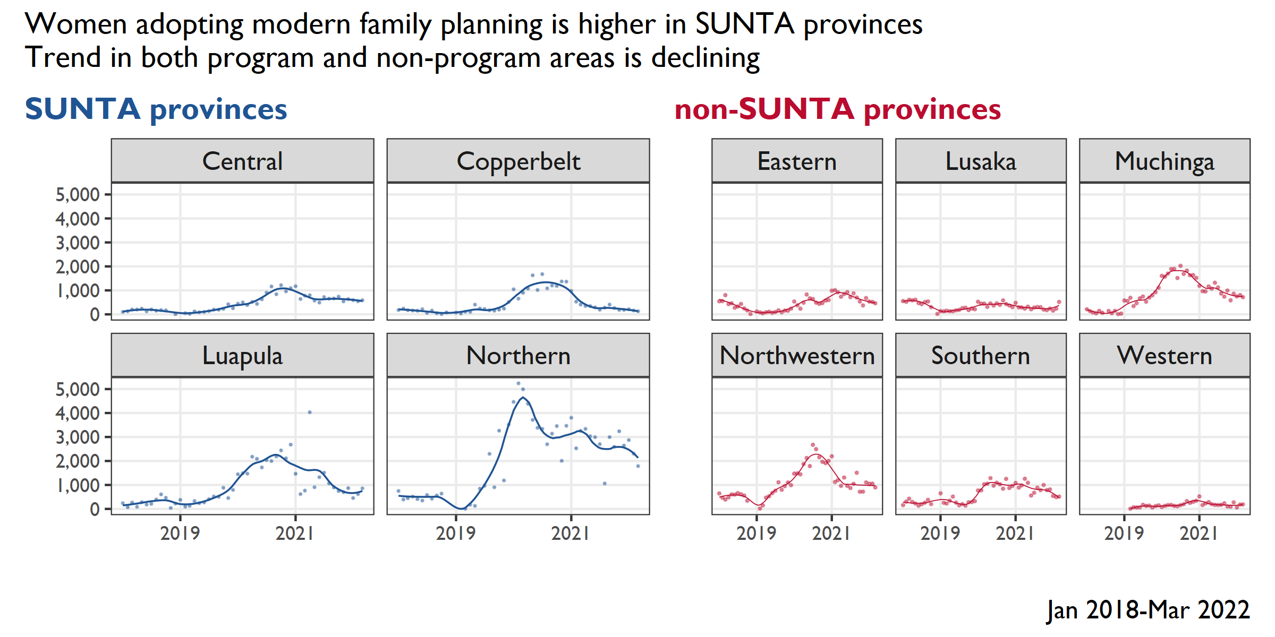

Slide 40
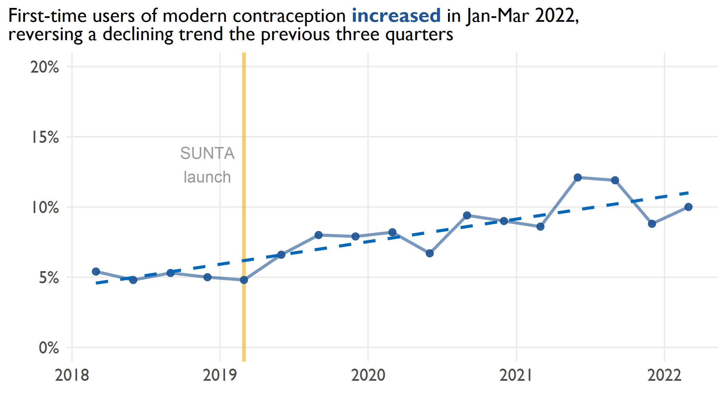

Slide 41
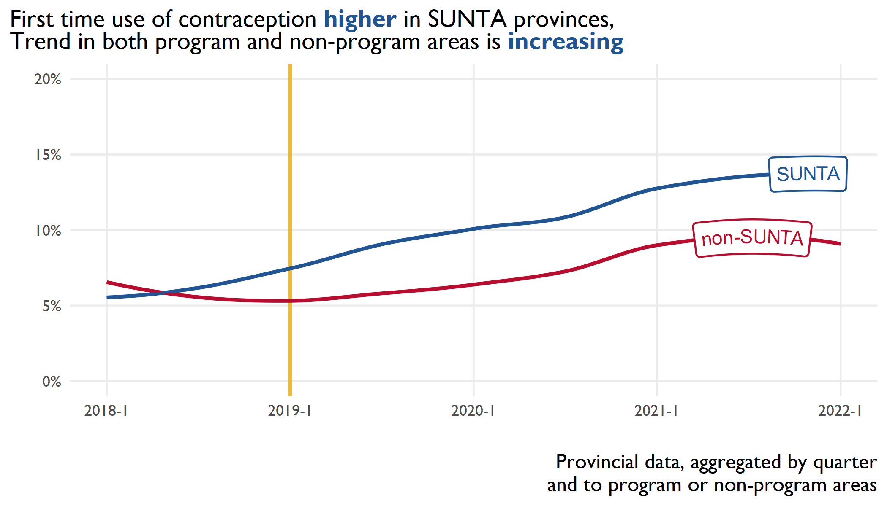

Slide 42
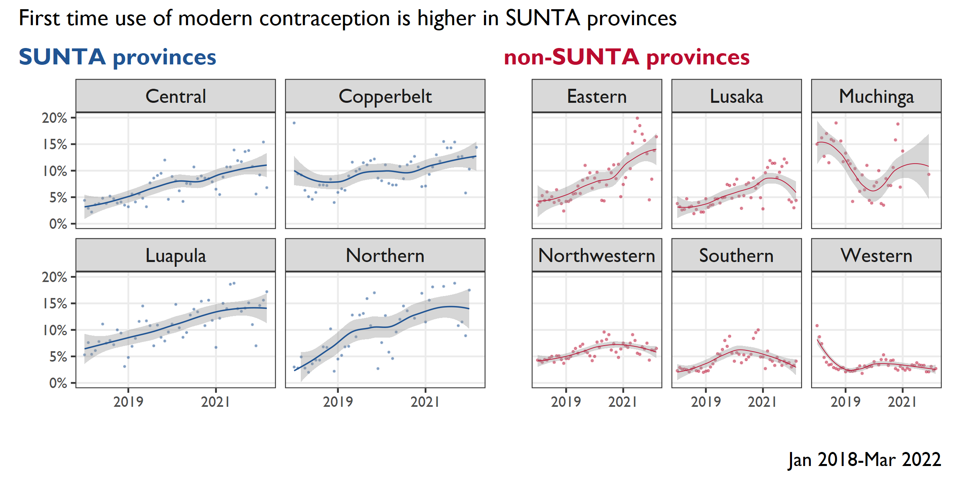

Slide 43
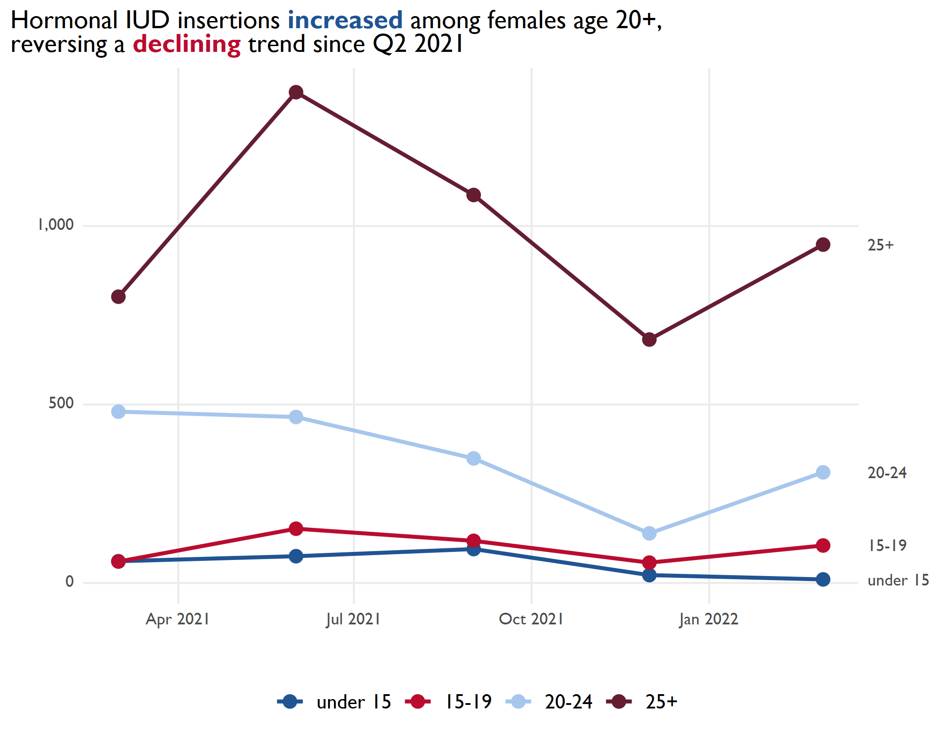
Hormonal IUD insertions increased among females age 20+ reversing a decline since Q2 2021

Slide 44
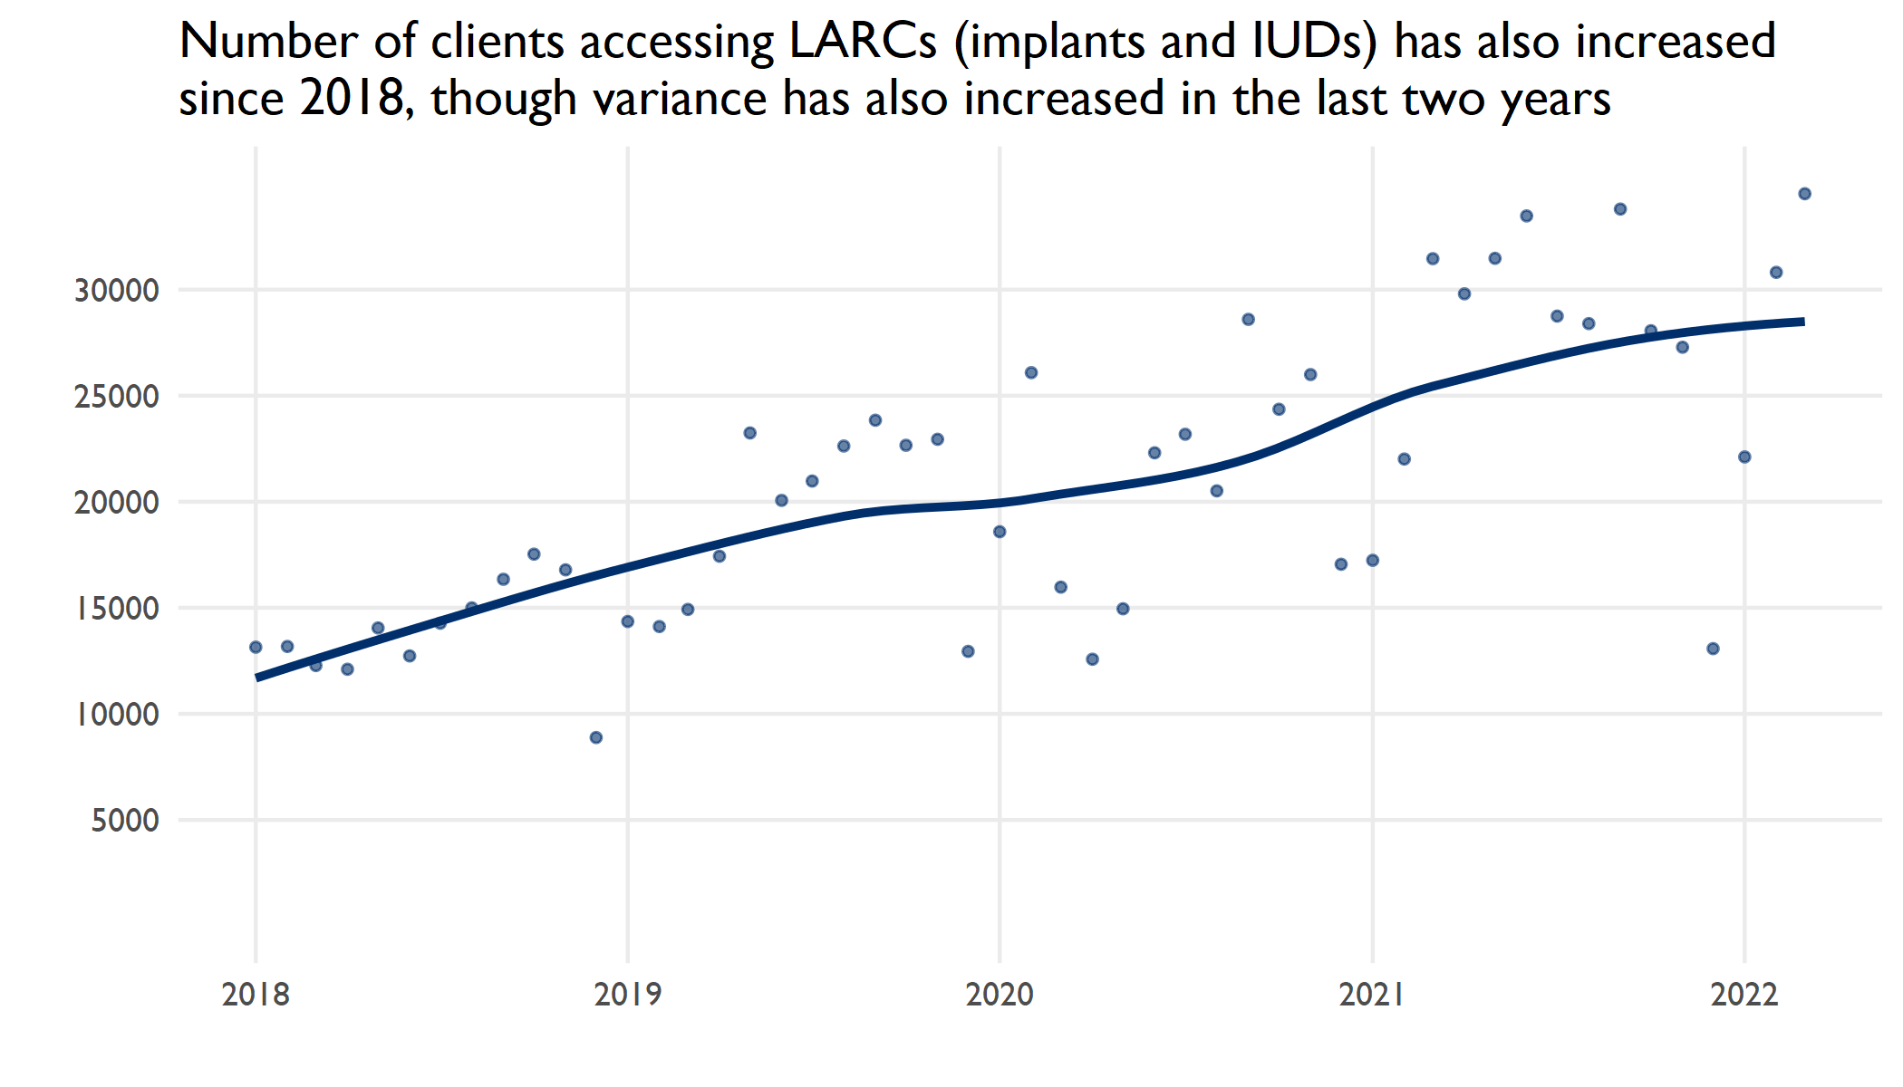

Slide 45
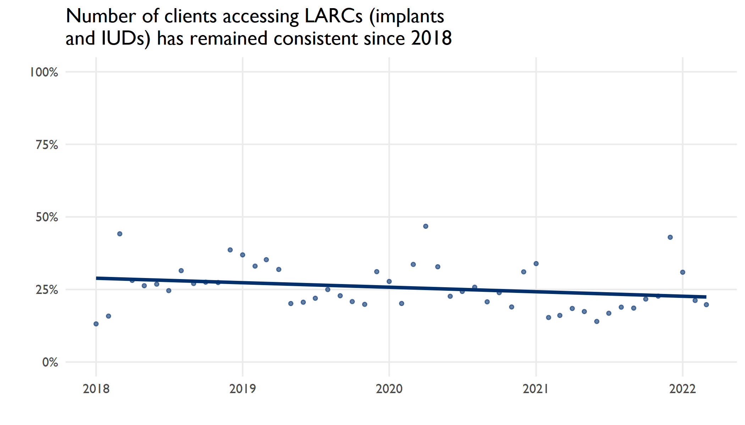
The ratio of number of clients removing LARCs to number of clients initiating LARC each month has declined slightly since 2018

Slide 46
Q&A

